Slide 1


PEHR
UNIVERSITAS PENDIDIKAN INDONESIA
Physical Education, Health, and Recreation
STUDY PROGRAM
Faculty of Sport Education and Health
ANALYTICAL STUDY OF THE PROCESS OF CREATING BENCHMARKS FOR OFFENSIVE AND DEFENSIVE BASKETBALL ABILITIES
Abyan Hazemi Id’ham Fahmi
Universitas Pendidikan Indonesia

Slide 2







PEHR
UNIVERSITAS PENDIDIKAN INDONESIA
Physical Education, Health, and Recreation
STUDY PROGRAM
Faculty of Sport Education and Health
01. First slide: Title, Author(s), Affiliation(s).
02. Slide 2-3: Introduction
PowerPoint Structure:
03. Slide 4: Methods
04. Slide 5-6:Rsult & Discussion
05. Slide 7: Conclusion
06. Slide 8: References

Slide 3
PEHR
Introduction
UNIVERSITAS PENDIDIKAN INDONESIA
Physical Education, Health, and Recreation
STUDY PROGRAM
Faculty of Sport Education and Health
Benchmark products are one of the latest innovations in the field of sports.
Particularly in basketball, there are no benchmarks related to the selection process for offensive and defensive abilities.
The components that are evaluated include physical condition, mental condition, intelligence, motor skills, technique, and several other components that support the identification of an athlete's talent (Litkowycz R, et al 2014).
Therefore, researchers are trying to create a product that helps coaches identify offensive and defensive skills in basketball.
Presentation Template 6th ISPESH 2026

Slide 4
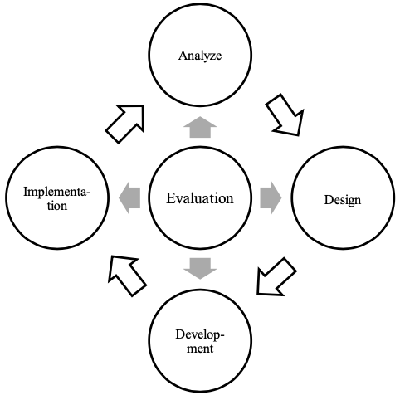
Methods
Research & Development Method
No. | Panel Member | Affiliation
1 | Coach 1 | Akademi Bandung Utama
2 | Coach 2 | Cendrawasih Bandung
3 | Coach 3 | Rajamantri Bandung
4 | Coach 4 | Kassiti Bandung Knights
5 | Coach 5 | Metro Starlight
Design ADDIE (2010)
MMR (Mixed Method Research) which combined several data collection techniques, starting from FGD (Focus Group Discussion) to the benchmark item indicator scoring stage

Slide 5
Result
The model for selecting basketball player indicators is designed to help coaches identify talented local athletes. In the process of identifying athletic talent, several indicators must be considered during the selection process. The results of the analysis reveal that there are currently no suitable indicators regarding the process of identifying athletic talent. Several indicators are needed to assess the subjectivity of the selection process for local athletes.
No | Indikator | Skor/Rating
1. | Coach Instict – The Coaches Eye | 4
2. | Drive & Ambition | 3
3. | Physical & Technical Skills | 4
4. | Game Intellegence | 4
5. | Skill Execution | 3
6. | Decision Making | 4
7. | Support | 3

Slide 6
Discussion
Coach Instict – The Coaches Eye
The above indicator was given a score of 4, with the following reasons: A coach can identify the factors that characterize an ideal player, focusing on practicality for talented athletes. Sometimes coaches are still unable to make clear decisions about what makes an ideal and talented player for the future.
Drive & Ambition
The second indicator was given a score of 3 for the following reasons, coaches believe that an important part of identifying talented athletes is psychological traits that can be interpreted as ‘drive and ambition’.These characteristics are observed through observation and understanding of athletes, especially based on long-term observation of players.
Physical & Technical Skills
The third indicator was given a score of 4 for the following reasons: Most of the articles included refer to physical attributes, such as physiological and anthropometric factors. An important part for coaches is that athletes have physical talents that demonstrate superior athletic skills and have anthropometric characteristics that are advantageous for basketball.
Game Intellegence
The fourth indicator was given a score of 4. The reasons are as follows: Game intelligence, or the ability to read the game, is another key indicator commonly used to assess talent and is demonstrated through the ability to make ‘decisions’ or ‘solve problems’ in the context of the game.
Skill Execution
The fifth indicator was given a score of 3 for the following reasons skill execution is one of the indicators that every player must have. Skill execution usually occurs when a player is attacking or defending on the court.
Decision Making
The sixth indicator was given a score of 4 for the following reasons decision making is a goal-oriented cognitive process in which individuals assess available information to make judgments and selections. In the context of sports, this process is called sports decision-making.
Support
The last indicator was given a score of 3 for the following reason: basketball is a game that focuses on movement with and without the ball.

Slide 7
Conclusion
This study shows that there has been no previous research that has constructed a benchmark for talent identification products. The results of this product mention several required indicators. These include 1. Coach Eye – Coach Instinct, 2. Drive & Ambition, 3. Physical & Technical Skills, 4. Game Intelligence, 5. Skill Execution, 6. Decision Making, 7. Support. Due to the limitations of the experts, this product has indicators that are tailored to regional needs. The general objective is to assist in the long-term development of athletes. The focus is on coaching young athletes in the region.

Slide 8
References
Araújo, R., Delgado, M., Azevedo, E., & Mesquita, I. (2020). Students’ tactical understanding during a hybrid sport education/step-game approach model volleyball teaching unit. Movimento, 26(1), 1–16. https://doi.org/10.22456/1982-8918.97764
Branch, R. M. (2010). Instructional design: The ADDIE approach. In Instructional Design: The ADDIE Approach. Springer US. https://doi.org/10.1007/978-0-387-09506-6
Čaušević, D., Čović, N., Abazović, E., Rani, B., Manolache, G. M., Ciocan, C. V., Zaharia, G., & Alexe, D. I. (2023). Predictors of Speed and Agility in Youth Male Basketball Players. Applied Sciences (Switzerland), 13(13). https://doi.org/10.3390/app13137796
Choi, D.-H., Kim, S.-M., Lee, J.-W., Suh, S.-H., & So, W.-Y. (2015). Winning Factors: How Players’ Positional Offensive and Defensive Skills Affect Probability of Victory in the Korea Basketball League. In International Journal of Sports Science & Coaching (Vol. 10). http://www.koreabasketball.or.kr
Faber, I. R., Koopmann, T., Büsch, D., & Schorer, J. (2021). Developing a tool to assess technical skills in talented youth table tennis players—a multi-method approach combining professional and scientific literature and coaches’ perspectives. Sports Medicine - Open, 7(1). https://doi.org/10.1186/s40798-021-00327-5
Goncalves, L. ; S. A. ; T. F. ; Y. J. M. (2017). art11. Cuadernos de Psicología Del Deporte, 17(3), 129–136.
Gryko, K. (2021). Effect of maturity timing on the physical performance of male Polish basketball players aged 13 to 15 years. Scientific Reports, 11(1). https://doi.org/10.1038/s41598-021-01401-4
Guo, Z., & Wang, Q. (2025). The impact of time pressure on decision-making and visual search characteristics in basketball players. Frontiers in Psychology, 16. https://doi.org/10.3389/fpsyg.2025.1660732

