Slide 1








UNIVERSITAS PENDIDIKAN INDONESIA
PEHR
Physical Education, Health, and Recreation
STUDY PROGRAM
Faculty of Sport Education and Health
Implementation of Teaching Games for Understanding (TGfU) to Improve Students’ Badminton Game Performance
Beni Rafly Oktavian
Universitas Pendidikan Indonesia
Faculty of Sport and Health Education
Physical Education, Health, and Recreation Study Program

Slide 2


Introduction
UNIVERSITAS PENDIDIKAN INDONESIA
PEHR
Physical Education, Health, and Recreation
STUDY PROGRAM
Faculty of Sport Education and Health
Physical education aims to develop students' cognitive, affective, and psychomotor competencies through meaningful learning experiences. However, badminton instruction in junior high schools is still predominantly teacher-centered and focuses on repetitive technical drills, limiting students' opportunities to develop tactical understanding and decision-making skills in authentic game situations.

Slide 3
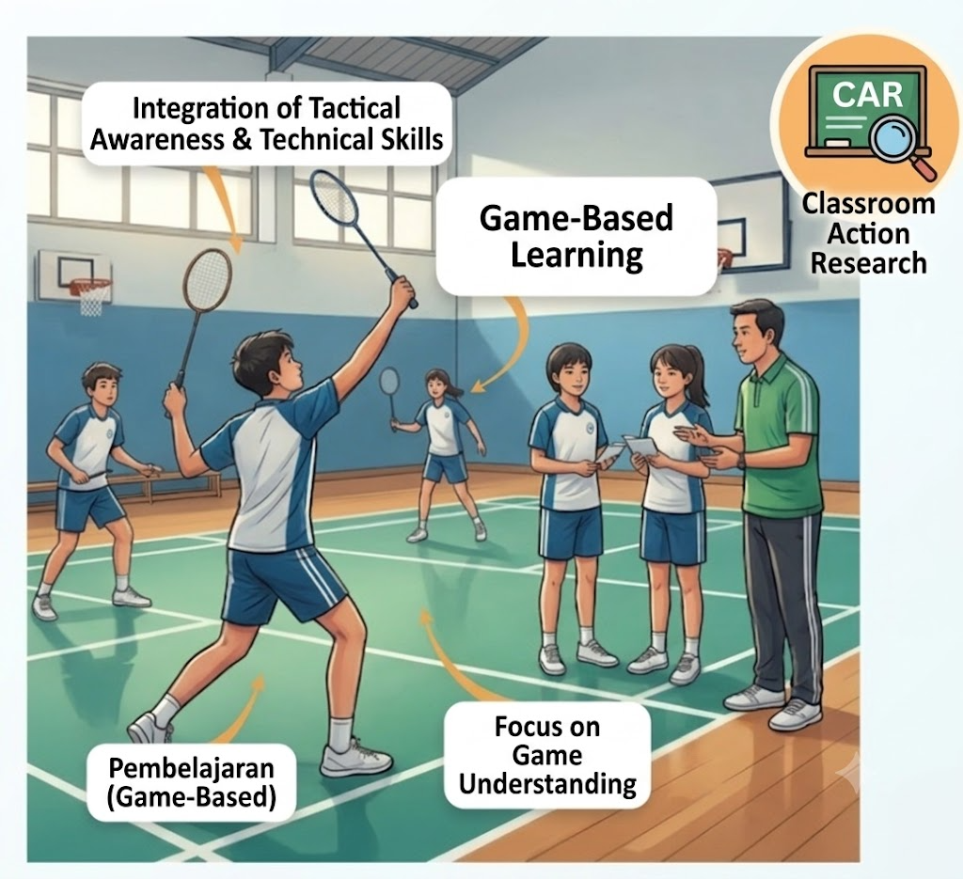
Introduction
UNIVERSITAS PENDIDIKAN INDONESIA
PEHR
Physical Education, Health, and Recreation
STUDY PROGRAM
Faculty of Sport Education and Health
Teaching Games for Understanding (TGfU) offers a game-based instructional approach that integrates tactical awareness with technical skill development. Although previous studies have demonstrated the effectiveness of TGfU in improving game performance, limited research has investigated its implementation through Classroom Action Research in Indonesian junior high school badminton classes using the Game Performance Assessment Instrument (GPAI). Therefore, this study aimed to investigate the implementation of the TGfU learning model in improving students' badminton game performance

Slide 4
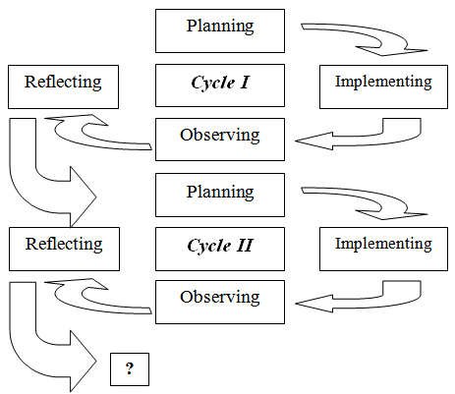
Method
UNIVERSITAS PENDIDIKAN INDONESIA
PEHR
Physical Education, Health, and Recreation
STUDY PROGRAM
Faculty of Sport Education and Health
This study employed a Classroom Action Research (CAR) design based on the Kemmis and McTaggart model, consisting of planning, action, observation, and reflection implemented in two action cycles. The participants were 68 eighth-grade students from Classes VIII D and VIII H at SMP Negeri 14 Bandung, Indonesia. The intervention was conducted using the Teaching Games for Understanding (TGfU) learning model, which emphasizes learning through modified games, tactical awareness, decision making, and skill execution.

Slide 5
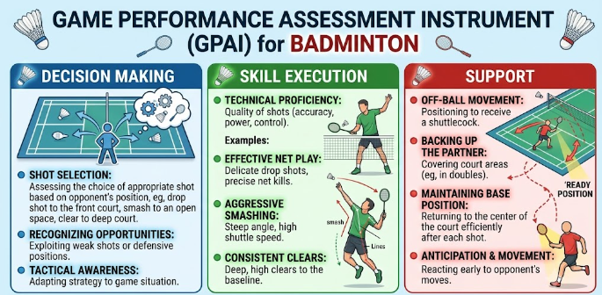
Method
UNIVERSITAS PENDIDIKAN INDONESIA
PEHR
Physical Education, Health, and Recreation
STUDY PROGRAM
Faculty of Sport Education and Health
Students' badminton game performance was assessed using the Game Performance Assessment Instrument (GPAI), focusing on three indicators: decision making, skill execution, and support. The collected data were analyzed descriptively by comparing students' game performance across the two research cycles.

Slide 6
Result
UNIVERSITAS PENDIDIKAN INDONESIA
PEHR
Physical Education, Health, and Recreation
STUDY PROGRAM
Faculty of Sport Education and Health
The implementation of the Teaching Games for Understanding (TGfU) learning model resulted in a consistent improvement in students' badminton game performance throughout the two action research cycles. The mean GPAI scores increased from 50.29 to 73.35 in Class VIII D and from 47.97 to 77.15 in Class VIII H. Similarly, students' learning mastery improved substantially, reaching 76.47% in Class VIII D and 79.41% in Class VIII H by the end of Cycle II. Furthermore, all GPAI performance indicators demonstrated positive development, with the greatest improvement observed in decision making, followed by support and skill execution. These findings indicate that TGfU effectively enhanced students' tactical understanding and overall badminton game performance.

Slide 7
Result
UNIVERSITAS PENDIDIKAN INDONESIA
PEHR
Physical Education, Health, and Recreation
STUDY PROGRAM
Faculty of Sport Education and Health
Table Development of Students' Badminton Game Performance Across the Action Cycles
Cycle | Class | Students Achieving Mastery (n) | Mastery (%) | Mean GPAI Score
Cycle I – Meeting 1 | VIII D | 4 | 11.76 | 50.29
Cycle I – Meeting 1 | VIII H | 1 | 2.94 | 47.97
Cycle I – Meeting 2 | VIII D | 8 | 23.53 | 57.12
Cycle I – Meeting 2 | VIII H | 6 | 17.65 | 60.44
Cycle II – Meeting 1 | VIII D | 17 | 50.00 | 59.18
Cycle II – Meeting 1 | VIII H | 19 | 55.88 | 69.26
Cycle II – Meeting 2 | VIII D | 26 | 76.47 | 73.35
Cycle II – Meeting 2 | VIII H | 27 | 79.41 | 77.15

Slide 8
Discussion
UNIVERSITAS PENDIDIKAN INDONESIA
PEHR
Physical Education, Health, and Recreation
STUDY PROGRAM
Faculty of Sport Education and Health
The findings indicate that the Teaching Games for Understanding (TGfU) learning model effectively improved students' badminton game performance by integrating tactical understanding with technical skill development. Through modified games and tactical problem-solving activities, students became more capable of making appropriate decisions, executing skills effectively, and providing better support during game situations. The greatest improvement was observed in the decision-making component, suggesting that learning in authentic game contexts enhances students' tactical awareness and game intelligence. These findings are consistent with previous studies, which reported that TGfU promotes decision making, tactical understanding, and overall game performance more effectively than traditional technique-based instruction (Bunker & Thorpe, 1986; Abad Robles et al., 2020; Barba-Martín et al., 2020; Fagundes et al., 2023).

Slide 9
Conslusion
UNIVERSITAS PENDIDIKAN INDONESIA
PEHR
Physical Education, Health, and Recreation
STUDY PROGRAM
Faculty of Sport Education and Health
The implementation of the Teaching Games for Understanding (TGfU) learning model effectively improved junior high school students' badminton game performance. The continuous improvement in GPAI scores, learning mastery, and performance indicators demonstrates that TGfU successfully enhanced students' decision making, skill execution, and support during game play. By engaging students in authentic game situations, TGfU promoted tactical understanding while simultaneously developing technical skills. Therefore, TGfU can be considered an effective and student-centered instructional model for improving badminton learning outcomes in physical education.

Slide 10
References
UNIVERSITAS PENDIDIKAN INDONESIA
PEHR
Physical Education, Health, and Recreation
STUDY PROGRAM
Faculty of Sport Education and Health
Foundational References | Supporting Research
Bunker, D., & Thorpe, R. (1986). Rethinking Games Teaching. | Abad Robles, M. T., McRobert, A. P., & Moreno, M. P. (2020). Human Movement Science.
Griffin, L. L., & Butler, J. I. (2005). Teaching Games for Understanding: Theory, Research, and Practice. | Barba-Martín, R. A., et al. (2020). International Journal of Environmental Research and Public Health.
Mitchell, S. A., Oslin, J. L., & Griffin, L. L. (2013). Teaching Sport Concepts and Skills (3rd ed.). | Fagundes, P., et al. (2023). Retos.
Oslin, J. L., Mitchell, S. A., & Griffin, L. L. (1998). Journal of Teaching in Physical Education. | Junanda, J., et al. (2025). Systematic Review of TGfU in Badminton Learning.
Kemmis, S., & McTaggart, R. (2014). The Action Research Planner. | UNESCO. (2015). Quality Physical Education (QPE): Guidelines for Policy-Makers.
Note: A complete list of references is available in the full manuscript.

Slide 11
UNIVERSITAS PENDIDIKAN INDONESIA
PEHR
Physical Education, Health, and Recreation
STUDY PROGRAM
Faculty of Sport Education and Health
Thank you for your attention.

