Slide 1








PEHR
UNIVERSITAS PENDIDIKAN INDONESIA
Physical Education, Health, and Recreation
Enhancing Enthusiasm For Learning Badminton Through a Tactical Approach Model Among 10th-grade Students at SMAN 2 Subang.
Fazka Affarizqa Mulyana
Universitas Pendidikan Indonesia

Slide 2


PEHR
UNIVERSITAS PENDIDIKAN INDONESIA
Physical Education, Health, and Recreation
01. 02. 03. 04. 05. 06.
First slide: Title, Autho
Slide 2-3: Introduction
Slide 4: Methods
Slide 5-6:Rsult & Discussion
Slide 7: Conclusion
Slide 8: References
PowerPoint Structure:

Slide 3
PEHR
UNIVERSITAS PENDIDIKAN INDONESIA
Physical Education, Health, and Recreation
Physical education aims not only to develop students' movement skills but also to foster active lifestyles, sportsmanship, cooperation, responsibility, and decision-making abilities during game situations. In badminton instruction, students are expected to master basic techniques while understanding when and how these techniques should be applied effectively during play.
However, badminton learning is often teacher-centered and emphasizes repetitive technical drills. As a result, many students understand techniques in isolation but struggle to apply them in real game situations, leading to low enthusiasm and limited engagement during learning activities.
INTRODUCTION

Slide 4





PEHR
Research Gap
Research on game-based learning has demonstrated that tactical approaches contribute positively to physical education. Previous studies reported that the Tactical Games Model improves students' self-confidence, physical activity enjoyment, learning motivation, and badminton learning outcomes.
However, previous studies have primarily focused on learning outcomes and motivation, while evidence regarding the implementation of a tactical approach to improve students' enthusiasm for learning badminton through Classroom Action Research at the senior high school level remains limited. More contextual evidence is needed to explain how this approach influences students' engagement during the learning process.
Therefore, this study aims to describe the implementation of a tactical approach model to enhance the enthusiasm for learning badminton among Grade X students at SMAN 2 Subang through classroom action research.

Slide 5
PEHR
RESEARCH METHODS
Research Design
Research Instruments
This study employs Classroom Action Research (CAR) based on the Kemmis and McTaggart model, comprising the stages of planning, action implementation, observation, and reflection. The research was conducted through a pre-cycle, Cycle I, and Cycle II to improve the learning process incrementally.
The research instrument consisted of a learning enthusiasm observation sheet comprising seven indicators: attention, active engagement, perseverance, resilience (not giving up easily), participation, involvement in the game, and application of tactics.
Research Population
Data Analysis
The research subjects were 43 Grade X students at SMAN 2 Subang, selected based on the need to improve the badminton learning process through the use of a tactical approach model..
The data were analyzed using quantitative descriptive analysis, encompassing the calculation of mean scores, percentages, categories, and frequency distributions, as well as the improvement in results from the pre-cycle stage to Cycle II..

Slide 6
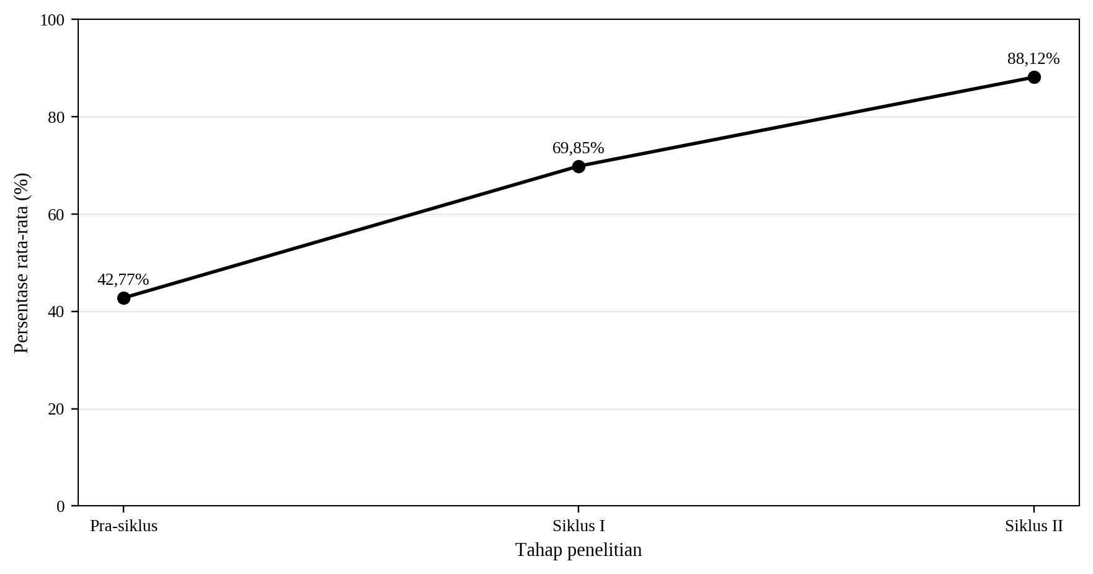


PEHR
RESEARCH RESULT
The implementation of the tactical approach improved students' learning enthusiasm throughout every research stage. The average percentage increased from 42.77% during the pre-cycle to 69.85% in Cycle I and reached 88.12% in Cycle II.The category distribution also improved considerably. Initially, all students were categorized as poor or very poor. After the intervention, most students reached the good category in Cycle I and the very good category in Cycle II, indicating substantial improvement in learning enthusiasm.
09

Slide 7
PEHR
The implementation of the tactical approach successfully increased students' enthusiasm for learning badminton. Through modified games, tactical discussions, relevant technical drills, and game reapplication, students became more actively involved in learning and were better able to connect technical skills with real game situations.
01.
The findings indicate improvements in students' attention, active participation, perseverance, resilience, game involvement, and tactical application throughout the research cycles. These improvements suggest that learning activities based on game situations create a more meaningful learning experience and encourage students to participate more confidently in badminton instruction.
02
DISCUSSION
These results are consistent with previous studies by Jalilvand et al. (2023), Nur et al. (2024), and Light (2012), which emphasize that tactical approaches enhance students' motivation, engagement, and learning outcomes by integrating decision-making with skill execution in meaningful game contexts.
03.

Slide 8

PEHR
CONCLUSION
The implementation of the tactical approach effectively improved badminton learning enthusiasm among Grade X students at SMAN 2 Subang. Students demonstrated continuous improvement across every research cycle, indicating that game-based learning created a more active, meaningful, and engaging learning environment.
Therefore, the tactical approach can be recommended as an alternative teaching model for badminton instruction by adjusting game rules, player numbers, court dimensions, and task difficulty according to students' abilities.

Slide 9
PEHR
REFERENCES
Aminnudin, T., Azizah, A. R., & Jasmani, P. (2025). DENGAN METODE TACTICAL GAME DI MTS. 8, 3289–3296.
Jalilvand, M. Ahmadi, A. H. et al. (2023). The Effectiveness of the Tactical Games Model on Self-efficacy , Physical Activity Enjoyment , and Learning of Badminton Serve. 15(3), 19–32.
Kemmis, S., McTaggart, R., & Nixon, R. (2014). The Action Research Planner: Doing Critical Participatory Action Research. Springer. https://doi.org/10.1007/978-981-4560-67-2
Light, R. L. (2012). Game Sense: Pedagogy for Performance, Participation and Enjoyment. Routledge (Taylor & Francis Group). https://doi.org/10.4324/9780203114643
Mitchell, S. A., Oslin, J. L., & Griffin, L. L. (2021). Teaching Sport Concepts and Skills: A Tactical Games Approach. Human Kinetics. https://books.google.co.id/books?id=tZ0AEAAAQBAJ
Nur, L., Muslihin, H. Y., Stephani, M. R., Wibowo, R., & Mustaqim, R. (2024). Effectiveness of Tactical Games Model Based on Teaching by Invitation for Enhance Learning Motivation and Physical Activity in Primary School Students. 4(1), 74–83. https://doi.org/10.53863/mor.v4i1.1143
Ricky, Z., Prasetyo, D. E., & Saputra, A. (2024). Pengembangan Model Pembelajaran Teknik Dasar Bulutangkis Untuk Siswa SMPN 1 Koto Baru. Athena: Physical Education and Sports Journal, 2(2), 1–17. https://doi.org/10.56773/athena.v2i2.22
S. Arikunto, Supardi, S. (2021). Penelitian Tindakan Kelas: Edisi Revisi. Bumi Aksara. https://books.google.co.id/books?id=-RwmEAAAQBAJ
09

Slide 10

THANK YOU
UNIVERSITAS PENDIDIKAN INDONESIA

