Slide 1








UNIVERSITAS PENDIDIKAN INDONESIA
PEHR
Physical Education, Health, and Recreation
STUDY PROGRAM
Faculty of Sport Education and Health
The Effectiveness of Digital
Technology Utilization in
Physical Education Learning
A Systematic Literature Review
Reival Erpati Denis
Universitas Pendidikan Indonesia

Slide 2


UNIVERSITAS PENDIDIKAN INDONESIA
PEHR
Physical Education, Health, and Recreation
STUDY PROGRAM
Faculty of Sport Education and Health
Introduction
Method
Results
Discussion
Conclusion
References
1.
2.
3.
4.
5.
6.
Outline

Slide 3
UNIVERSITAS PENDIDIKAN INDONESIA
PEHR
Physical Education, Health, and Recreation
STUDY PROGRAM
Faculty of Sport Education and Health
Introduction (1/2): Background
PE outcomes are embodied
Physical education outcomes are "embodied" : they live in the body, not just in the mind. The core focus is threefold: motor-skill acquisition, physical activity engagement, and health behaviour, alongside cognitive and psychosocial development.
Digital tools now span the full PE toolkit
Digital technology has now reached nearly every part of PE instruction : from LMS, mobile apps, AI, VR/AR, gamification, video analysis, to wearables and motion tracking. These tools are used across all education levels, from primary school through higher education.
Video and game-based feedback boost motor learning
Video-based feedback (e.g., recorded student movements that are analyzed) has been shown to accelerate motor-skill acquisition, especially when combined with expert- or self-modelling cues. Game-based approaches also consistently increase student motivation.
AI enables personalized, data-informed instruction
AI-based systems — such as automatic pose detection and adaptive feedback platforms : are beginning to enable personalized instruction tailored to each student, along with more objective, data-driven assessment of motor skills rather than relying solely on teacher judgment.

Slide 4
UNIVERSITAS PENDIDIKAN INDONESIA
PEHR
Physical Education, Health, and Recreation
STUDY PROGRAM
Faculty of Sport Education and Health
Introduction (2/2): Research Gap & Questions
Prior reviews are narrow in scope
Existing reviews tend to examine a single technology in isolation : for example, wearables alone or gamification alone. No prior review has comprehensively synthesized all types of digital PE technology in one unified study.
Equity and retention remain under-studied
Two things remain rarely investigated: first, whether these benefits are also achievable in under-resourced schools (equity of access); second, whether gains in motor skills and motivation persist after the intervention ends, or are merely short-lived effects.
RQ1 & RQ2: What, where, and how was it studied?
The first two research questions: (1) which technologies have been studied, and how are they distributed across countries and education levels; (2) what research designs and outcome measures were used to evaluate their effectiveness.
RQ3: What does the evidence actually show?
The third research question: what is the direction and consistency of the existing evidence regarding learning outcomes, motivation, motor skills, physical activity, and student engagement is it genuinely positive and consistent, or mixed across studies?

Slide 5
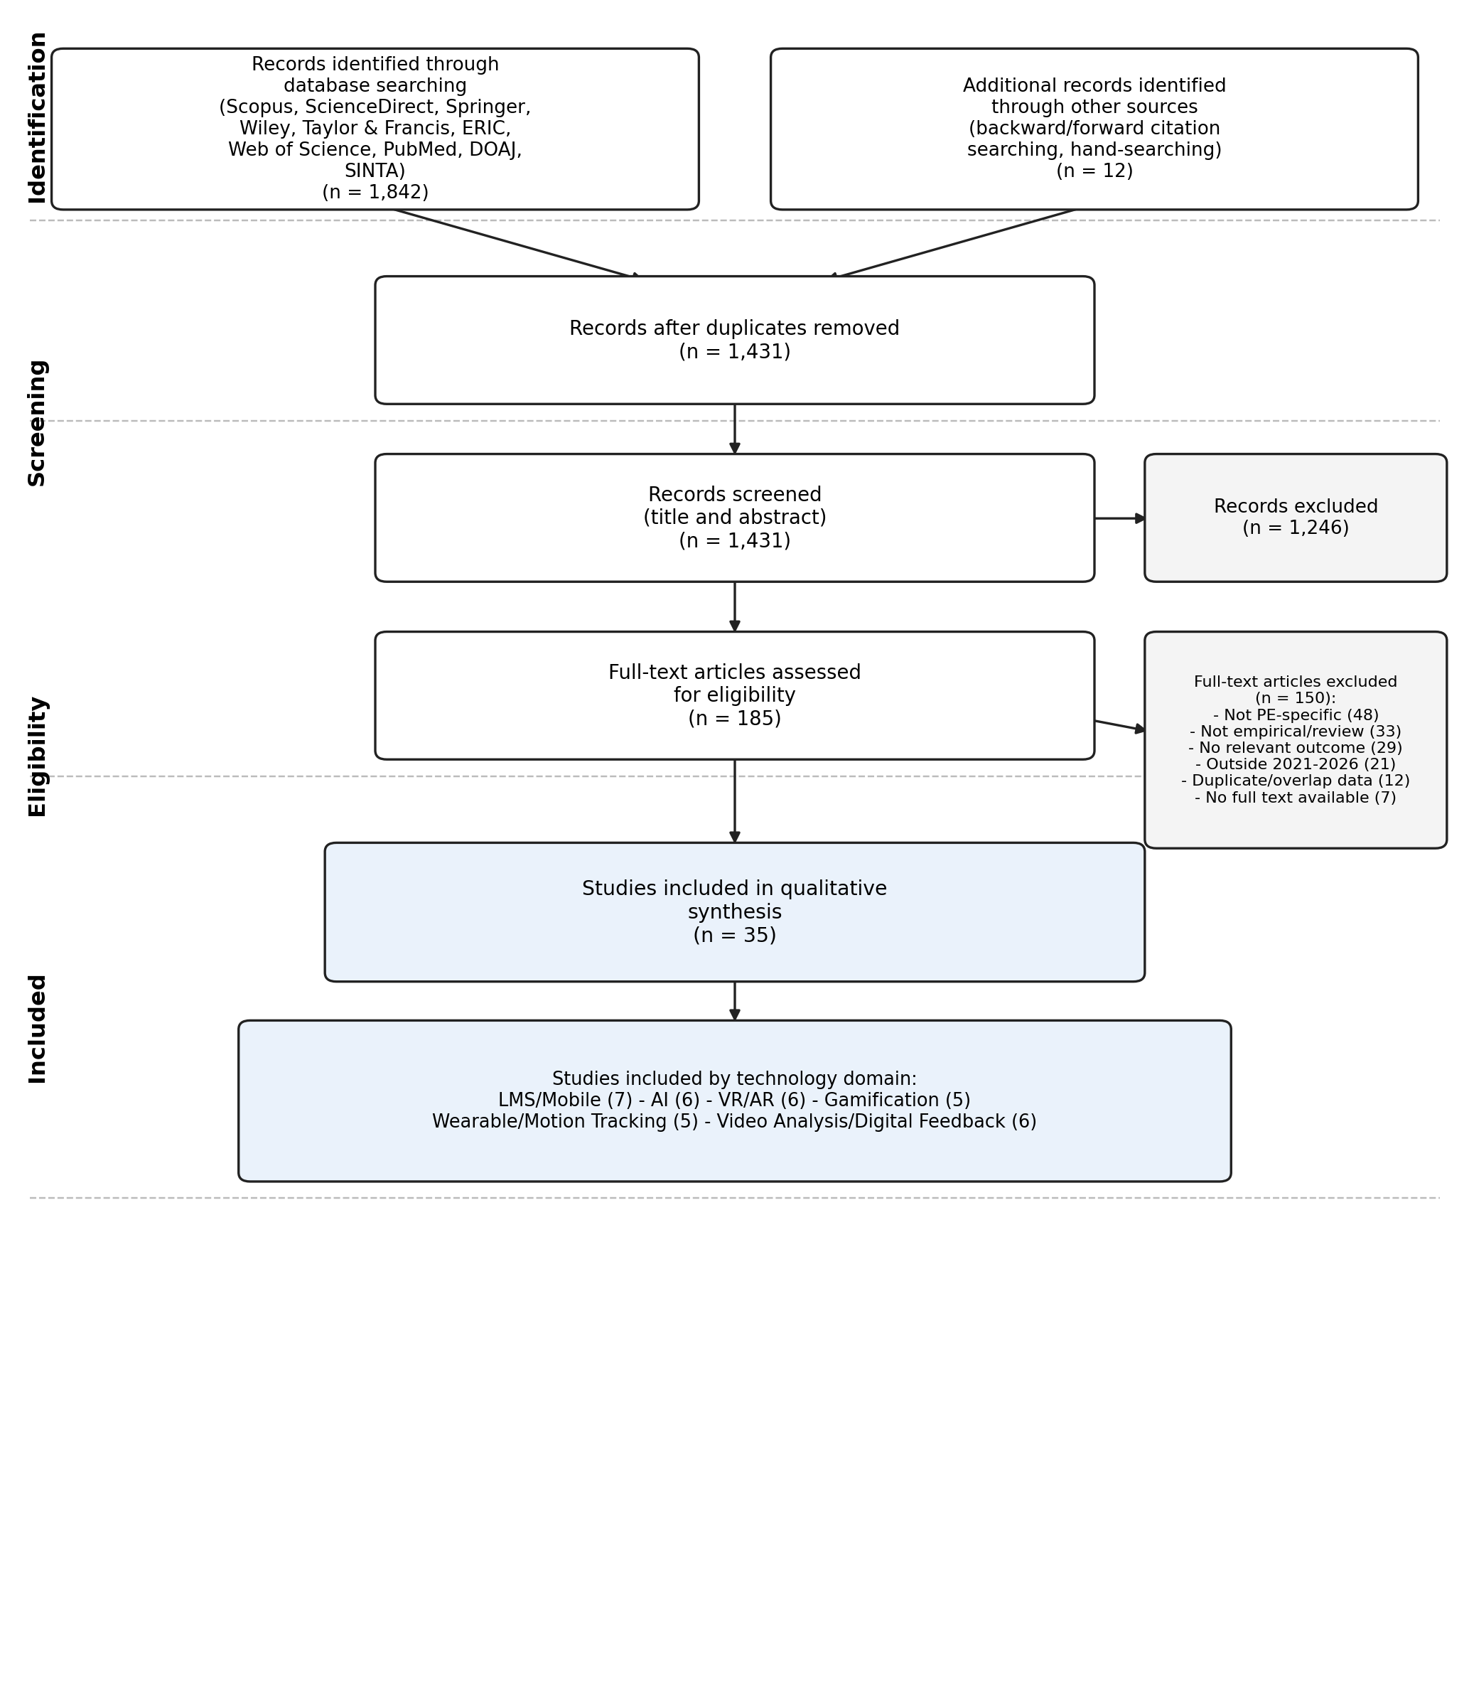
UNIVERSITAS PENDIDIKAN INDONESIA
PEHR
Physical Education, Health, and Recreation
STUDY PROGRAM
Faculty of Sport Education and Health
Method: PRISMA-Based Systematic Review
PRISMA 2020 guidelines
A Systematic Literature Review (SLR) was conducted following the PRISMA 2020 statement, covering identification, screening, eligibility, and inclusion stages.
9 databases searched
Scopus, ScienceDirect, Springer, Wiley, Taylor & Francis, ERIC, Web of Science, PubMed, and DOAJ, supplemented with SINTA for Indonesian national journals.
Eligibility criteria
PE-related digital-technology studies, published 2021-2026, peer-reviewed, with a valid DOI; conference abstracts and predatory-journal sources were excluded.
From 1,842 records to 35 studies
After duplicate removal, title/abstract screening, and full-text eligibility assessment, 35 studies met all criteria for the qualitative synthesis.

Slide 6
UNIVERSITAS PENDIDIKAN INDONESIA
PEHR
Physical Education, Health, and Recreation
STUDY PROGRAM
Faculty of Sport Education and Health
Results: What 35 Studies (2021-2026) Show
35
18
40%
studies included in the synthesis
countries represented
school-level; 34% higher-education
6
0
2021-2025
technology domains compared
domains with uniformly negative effects
publication years, rising each year
Clear patterns by technology domain
Gamification and VR/AR show the strongest motivation and engagement gains; video- and AI-based feedback show the strongest motor-skill precision gains; wearables show mixed physical-activity outcomes, depending on pedagogical scaffolding.

Slide 7
UNIVERSITAS PENDIDIKAN INDONESIA
PEHR
Physical Education, Health, and Recreation
STUDY PROGRAM
Faculty of Sport Education and Health
Discussion: Convergence, Divergence & Gaps
Findings converge with prior narrower reviews
The pattern of results aligns with independent reviews such as Tohanean et al. (2025) and Jastrow et al. (2022), strengthening confidence that benefits are not a single-context artefact.
Pedagogical design moderates outcomes as much as the tech
Wearable-technology studies show the most heterogeneous results: novelty effects fade without teacher-mediated goal-setting, suggesting design matters as much as the tool.
AI tools: optimism currently outpaces evidence
Enthusiasm for AI-based personalization is strong, but most underlying studies remain small, short-duration pilots rather than large-scale longitudinal trials.
Two persistent research gaps
Very few studies examine equity of access in under-resourced schools, and few include follow-up assessments beyond the intervention period to test retention.

Slide 8
UNIVERSITAS PENDIDIKAN INDONESIA
PEHR
Physical Education, Health, and Recreation
STUDY PROGRAM
Faculty of Sport Education and Health
Conclusion
Digital technology reliably supports PE learning
Consistent gains are found in motor-skill acquisition, learning motivation, and student engagement, especially from gamification and video/AI-based feedback.
Design and equity, not technology alone, drive results
Pedagogical scaffolding and equitable access moderate effectiveness at least as strongly as the specific tool being used.
Evidence base is promising but still maturing
Wearable-driven physical-activity gains remain mixed, and long-term retention of benefits is still rarely tested.
Next steps for research
Longitudinal designs, standardized outcome measures, and equity-focused implementation studies are needed to confirm these short-term gains.

Slide 9
UNIVERSITAS PENDIDIKAN INDONESIA
PEHR
Physical Education, Health, and Recreation
STUDY PROGRAM
Faculty of Sport Education and Health
Selected References
Tohanean et al. (2025)
Embedding digital technologies (AI and ICT) into physical education: a systematic review. Applied Sciences, 15(17), 9826.
Jastrow et al. (2022)
Digital technology in physical education: a systematic review of research from 2009 to 2020. German J. Exercise & Sport Research, 52, 504-528.
Montiel-Ruiz et al. (2023)
Social networks and gamification in physical education: a case study. Contemporary Educational Technology, 15(3), ep401.
Sousa, Ferrinho, & Travassos (2023)
The use of wearable technologies in the assessment of physical activity in youth: systematic review. IJERPH, 20(4), 3402.
Full list of 40 references
The complete, DOI-verified reference list is available in the accompanying manuscript.

