Slide 1




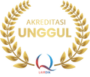

UNIVERSITAS PENDIDIKAN INDONESIA
PEHR
Physical Education, Health, and Recreation
STUDY PROGRAM
Faculty of Sport Education and Health
SPRINT INTERVAL TRAINING AND AEROBIC CAPACITY IN PENCAK SILAT ATHLETES: EVIDENCE FROM A CONTROLLED TRAINING INTERVENTION
Sabrina Khalisatu Zahra, Komarudin, Geraldi Novian
UNIVERSITAS PENDIDIKAN INDONESIA

Slide 2
UNIVERSITAS PENDIDIKAN INDONESIA
PEHR
Physical Education, Health, and Recreation
STUDY PROGRAM
Faculty of Sport Education and Health
INTRODUCTION
Pencak silat is a high-intensity sport that requires optimal physical fitness to maintain performance throughout a match.
Aerobic capacity is essential for delaying fatigue and sustaining performance
Sprint Interval Training (SIT) has been shown to improve VO₂max and aerobic capacity, but its effectiveness in pencak silat athletes remains underexplored.

Slide 3
UNIVERSITAS PENDIDIKAN INDONESIA
PEHR
Physical Education, Health, and Recreation
METHODS
STUDY PROGRAM
Faculty of Sport Education and Health
Research Method Quantitative experimental research using a Pretest–Posttest Control Group Design.
Research Instrument Yo-Yo Intermittent Recovery Test was used to assess aerobic capacity (VO₂max).
Population
Active athletes from PPSN Maung Lugay Pencak Silat Club, Bekasi, aged 14–17 years, with experience in national level competitions.
Sample
30 athletes selected using purposive sampling.
• Experimental group: 15 athletes (SIT)
• Control group: 15 athletes (Conventional Training)

Slide 4
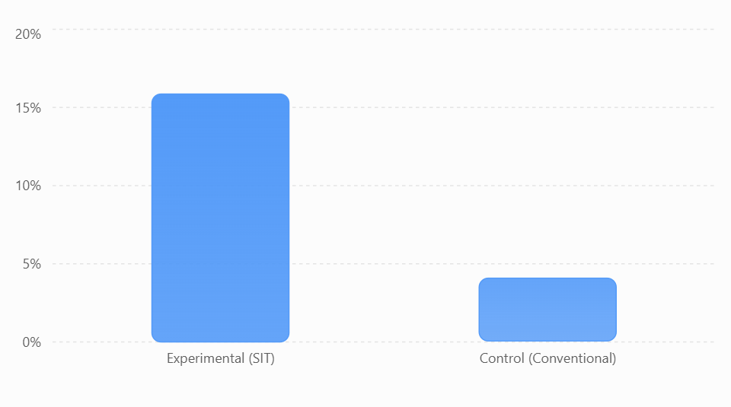
UNIVERSITAS PENDIDIKAN INDONESIA
RESULT
PEHR
Physical Education, Health, and Recreation
STUDY PROGRAM
Faculty of Sport Education and Health
The experimental group that went through the Sprint Interval Training (SIT) program saw a 15.86% increase in aerobic capacity, while the control group doing conventional training only saw a 4.08% increase. This shows that the SIT method is more effective at boosting aerobic capacity compared to conventional workouts.

Slide 5
UNIVERSITAS PENDIDIKAN INDONESIA
PEHR
Physical Education, Health, and Recreation
STUDY PROGRAM
DISCUSSION
Faculty of Sport Education and Health
.
  The study results show that both groups experienced improvements in aerobic capacity, but the increase in the experimental group was greater than in the control group. The experimental group, which followed the Sprint Interval Training (SIT) program, saw a 15.86% improvement in aerobic capacity, while the control group, which followed conventional training, had a 4.08% improvement. Paired sample t-test results showed significant improvement in each group, while independent sample t-test results indicated that the improvement in the experimental group's aerobic capacity was significantly higher than that of the control group.

Slide 6
UNIVERSITAS PENDIDIKAN INDONESIA
PEHR
Physical Education, Health, and Recreation
STUDY PROGRAM
Faculty of Sport Education and Health
CONCLUSION
Sprint Interval Training can be used as an effective workout method to boost the aerobic ability of pencak silat athletes and can be considered by coaches when designing training programs.

Slide 7
UNIVERSITAS PENDIDIKAN INDONESIA
PEHR
Physical Education, Health, and Recreation
STUDY PROGRAM
Faculty of Sport Education and Health
THANK YOU

