Slide 1








UNIVERSITAS PENDIDIKAN INDONESIA
PEHR
Physical Education, Health, and Recreation
STUDY PROGRAM
Faculty of Sport Education and Health
EFFECT BRAIN GYM ON MOTOR REACTION SPEED IN VOLLEYBALL LEARNING: A 2X2 FACTORIAL STUDY ON GENDER DIFFERENCES AMONG JUNIOR SCHOOL STUDENTS
Moch Fauzan Adhima
Universitas Pendidikan Indonesia

Slide 2


UNIVERSITAS PENDIDIKAN INDONESIA
PEHR
Physical Education, Health, and Recreation
STUDY PROGRAM
Faculty of Sport Education and Health
Introduction
Background
Many junior high school students show slow motor responses during volleyball learning.
Only 6.79% of Indonesian children aged 10–15 have good physical fitness.
78.9% of adolescents do not meet the 60-minute daily physical activity recommendation.
Most Brain Gym studies focus on young children, not junior high school volleyball learning.

Slide 3
UNIVERSITAS PENDIDIKAN INDONESIA
Reseach Gap & Purpose
PEHR
Physical Education, Health, and Recreation
STUDY PROGRAM
Faculty of Sport Education and Health
Research Gap
Most previous studies investigated:
Previous studies mainly focused on early childhood populations.
Limited evidence exists among junior high school students.
Few studies investigated Brain Gym in volleyball learning contexts.
Gender differences remain uncler
Introduction
Purpose
To Examine
The effect of Brain Gym on motor reaction.
The moderating role of gender.

Slide 4
UNIVERSITAS PENDIDIKAN INDONESIA
PEHR
Physical Education, Health, and Recreation
STUDY PROGRAM
Faculty of Sport Education and Health
Research Design
Quasi-Experimental 2x2 Factorial Design
Methods
Participants
Brain Gym Activities
Balance Buttons
Lazy 8
Arm Activation
Gravity Glinder
Double Doodle
Total Sample = 90 Student
School: SMPN 4 Rancaekek
Intervention
8 Session
4 Week
2 Seasons / Week
Instrumen
Ruller Drop Test

Slide 5
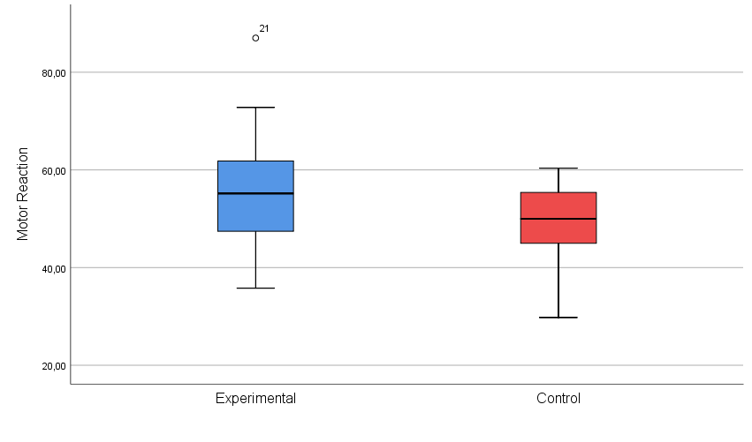
Result & Discussion
UNIVERSITAS PENDIDIKAN INDONESIA
PEHR
Physical Education, Health, and Recreation
STUDY PROGRAM
Faculty of Sport Education and Health
Descriptive Results
Main Effect
F = 11.421
P = 0.001
Significant
Brain Gym improved students' motor reaction performance.

Slide 6
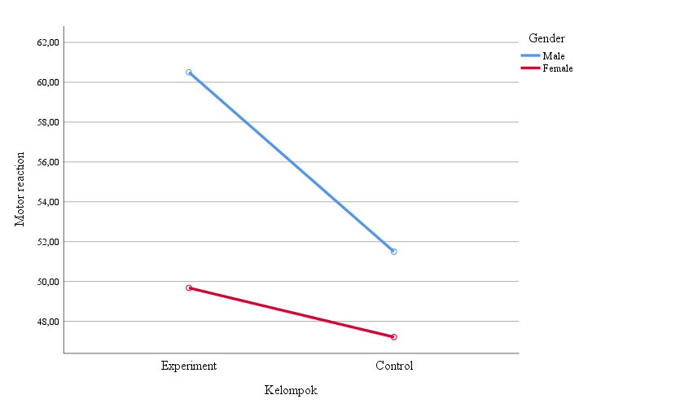
Result & Discussion
UNIVERSITAS PENDIDIKAN INDONESIA
PEHR
Physical Education, Health, and Recreation
STUDY PROGRAM
Faculty of Sport Education and Health
Tukey HSD
Interaction Effect
Significant
Not Significant
Interpretation
• Brain Gym benefited both genders.
• No significant gender interaction was found.
• Significant improvement occurred only among males.

Slide 7
UNIVERSITAS PENDIDIKAN INDONESIA
PEHR
Physical Education, Health, and Recreation
STUDY PROGRAM
Faculty of Sport Education and Health
Conclusion
✔ Brain Gym significantly improves motor reaction in volleyball learning.
✔ Experimental group performed better than control group.
✔ Gender did not significantly moderate the effect.
✔ Brain Gym can be implemented as a practical and low-cost warm-up strategy in physical education.
CONCLUSSION
Recommendation
Future studies should involve larger samples and longer intervention periods.

Slide 8
UNIVERSITAS PENDIDIKAN INDONESIA
PEHR
Physical Education, Health, and Recreation
STUDY PROGRAM
Faculty of Sport Education and Health
Ministry of Youth and Sports of the Republic of Indonesia. (2024). Performance report of the Ministry of Youth and Sports 2023.
World Health Organization, & Centers for Disease Control and Prevention. (2023). Global school-based student health survey (GSHS): Indonesia 2023 fact sheet. https://www.who.int/data/gho/data/themes/topics/gshs
Jalilinasab, S., Saemi, E., & Abedanzadeh, R. (2022). Fundamental motor and social skills of children: The role of Brain Gym exercise. Early Child Development and Care, 192(14), 2256–2267.
Ramos-Galarza, C., Aymacaña-Villacreses, C., & Cruz-Cárdenas, J. (2023). The intervention of Brain Gym in the mathematical abilities of high-school students: A pilot study. Frontiers in Psychology, 13, 1045567.
Varela, S., Ayan, C., Bidaurrazaga-Letona, I., Diz, J. C., & Dunabeitia, I. (2023). The effect of Brain Gym on cognitive function in older people: A systematic review and meta-analysis. Geriatric Nursing, 53, 175–180.
Thakre, V. M., Deshmukh, M., & Gibbs, J. (2024). Effectiveness of brain gym exercises over cognitive behavioural therapy in improving sleep quality among healthcare university students: A comparative study. Cureus, 16(4).
REFERENCES

