Slide 1








UNIVERSITAS PENDIDIKAN INDONESIA
PEHR
Physical Education, Health, and Recreation
STUDY PROGRAM
Faculty of Sport Education and Health
COMPARISON OF STUDENTS CONCENTRATION AND MOTIVATION LEVELS BETWEEN EARLY AND LATE CLASS SESSIONS IN PHYSICAL EDUCATION, SPORTS, AND HEALTH (PJOK) LEARNING AT SMP NEGERI 3 LEMBANG
Muhammad Fathan Nabil
Universitas Pendidikan Indonesia

Slide 2


UNIVERSITAS PENDIDIKAN INDONESIA
PEHR
Physical Education, Health, and Recreation
STUDY PROGRAM
Faculty of Sport Education and Health
Physical Education, Sports, and Health (PE) demands substantial physical activity, requiring high levels of active focus (concentration) and drive (motivation) from students.
A key administrative challenge is class scheduling, which triggers distinct physiological and psychological states:
Early Sessions (Morning): Students generally possess peak physical freshness and optimal alertness.
Late Sessions (Afternoon): Accumulation of academic fatigue, paired with the endogenously driven *post-lunch dip* (reduced vigilance post-meals).
This raises a crucial question: Does class timing significantly degrade students' cognitive efficiency and motivation to learn?
Background of the Study

Slide 3


UNIVERSITAS PENDIDIKAN INDONESIA
PEHR
Physical Education, Health, and Recreation
STUDY PROGRAM
Faculty of Sport Education and Health
Inconsistent Prior Findings
Research Purpose
Research Gaps & Objectives
Prior studies reveal a notable research gap. While some literature points to superior student participation and interest in morning classes, other empirical studies report neutral outcomes with no significant difference.
These inconsistencies are highly likely due to uncontrolled extraneous variables, such as varying instructors or disparate teaching materials across groups.
This study aims to empirically analyze differences in concentration and motivation by maintaining highly controlled, identical environments.
We compare Early Sessions (Periods 1-3) with Late Sessions (Periods 7-9) using a rigorous baseline: the same teacher, the same curriculum, and within the exact same week.

Slide 4



UNIVERSITAS PENDIDIKAN INDONESIA
PEHR
Physical Education, Health, and Recreation
STUDY PROGRAM
Faculty of Sport Education and Health
Research Design
Sample Data
Instruments & Analysis
Utilized a quantitative approach with a non-experimental ex post facto (causal-comparative) design. Independent variables were naturally occurring without researcher manipulation.
Included 222 seventh-grade students from SMPN 3 Lembang. 114 students represented the morning group (Periods 1-3) and 108 students formed the afternoon group (Periods 7-9).
Concentration was evaluated via the Concentration Grid Test (CGT). Motivation was measured via the Perceived Locus of Causality (PLOC) questionnaire. Analyzed using Independent Samples t-test.
Research Methodology

Slide 5
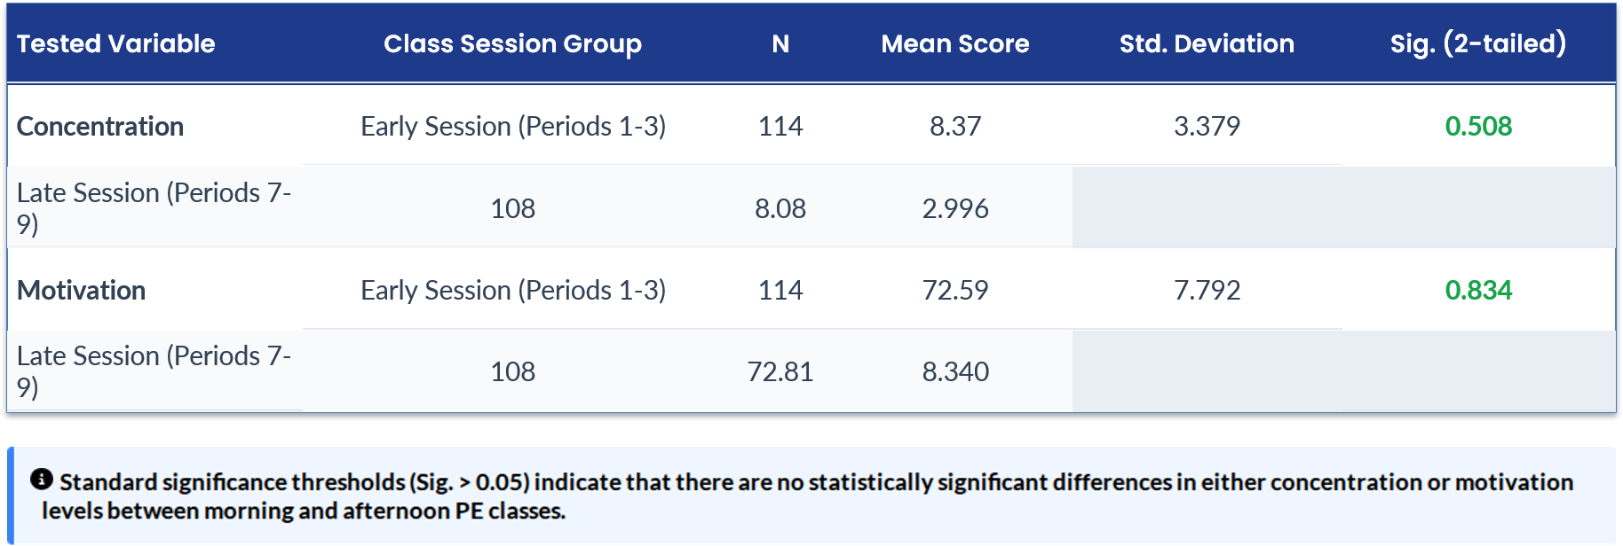
UNIVERSITAS PENDIDIKAN INDONESIA
PEHR
Physical Education, Health, and Recreation
STUDY PROGRAM
Faculty of Sport Education and Health
Data Analysis Results

Slide 6
UNIVERSITAS PENDIDIKAN INDONESIA
PEHR
Physical Education, Health, and Recreation
STUDY PROGRAM
Faculty of Sport Education and Health
Teacher's Pedagogical Intervention Strict variable controls ensured consistent quality of instruction, identical class management, and active pacing. The instructor's adaptive teaching style effectively countered students' natural midday fatigue.
Why No Difference Exists?
The Cathartic Effect of Physical Play Outdoor exercise in the afternoon triggers arousal and alertness hormones. PE functions as an emotional release valve, relieving mental tension accumulated during preceding indoor lectures.
Support for Self-Determination Theory (SDT) Fulfilling core psychological needs (autonomy, competence, relatedness) breeds resilient internal motivation. This stable locus of causality prevents environmental or timing parameters from dictating student interest.

Slide 7
UNIVERSITAS PENDIDIKAN INDONESIA
PEHR
Physical Education, Health, and Recreation
STUDY PROGRAM
Faculty of Sport Education and Health
Conclusion
Class scheduling is not the primary determinant of student psychological states in PE. Quality control factors, such as teacher strategies, pedagogical design, and basic psychological need fulfillment, play a far more dominant role.
"
"

Slide 8
UNIVERSITAS PENDIDIKAN INDONESIA
PEHR
Physical Education, Health, and Recreation
STUDY PROGRAM
Faculty of Sport Education and Health
Alfarabi, M. R., & Kuntjoro, B. F. T. (2024). Perbandingan Minat Belajar PJOK Berdasarkan Waktu Pembelajaran. Jurnal Ilmu Keolahragaan.
Deci, E. L., & Ryan, R. M. (2000). The "what" and "why" of goal pursuits: Human needs and self-determination. Psychological inquiry.
Fachrudin, F. A. (2017). Perbedaan Motivasi Belajar Siswa pada Pembelajaran PJOK Antara Jam Pelajaran Awal dan Akhir. Jurnal Pendidikan Olahraga.
Purwanto, G. (2018). Perbandingan Tingkat Konsentrasi dan Motivasi Siswa Pembelajaran PJOK. Jurnal Pendidikan Olahraga dan Kesehatan.
Suriyanto, E. A. N. (2017). Perbandingan Motivasi Belajar PJOK Siswa Jam Pagi dan Jam Siang. Jurnal Pendidikan Olahraga.
Key References

