Slide 1








PEHR
UNIVERSITAS PENDIDIKAN INDONESIA
Physical Education, Health, and Recreation
INNOVATIONS IN GAME-BASED LEARNING IN PHYSICAL EDUCATION AND THEIR IMPACT ON STUDENTS MOTOR SKILLS AND MOTIVATION TO LEARN: A SYSTEMATIC LITERATURE REVIEW
Universitas Pendidikan Indonesia
Nabila Azzahra

Slide 2


PEHR
Introduction
UNIVERSITAS PENDIDIKAN INDONESIA
Physical Education, Health, and Recreation
Current Condition:
PE instruction in many schools is still dominated by technical drills and repetitive exercises → students feel bored, underchallenged, and lose motivation
The digital generation is more familiar with electronic games than conventional physical activities
PE teachers are required to provide more engaging and contextual learning experiences
Ideal Condition:
PE should simultaneously develop physical fitness, motor skills, character, and mental health
Learning needs to integrate play, challenge, and social interaction — the core principle of Game-Based Learning (GBL)
GBL (distinct from mere gamification) uses games themselves as the primary means to achieve learning goals, spanning modified traditional games, tactical models (TGfU), digital gamification, and AR/VR-based exergames

Slide 3
PEHR
Introduction
UNIVERSITAS PENDIDIKAN INDONESIA
Physical Education, Health, and Recreation
Urgency of the Study:
The two key variables, motor skills and learning motivation, have been shown to improve through GBL, but findings remain scattered across publication types, cultural contexts, education levels, and research designs
A systematic review is needed to summarize and synthesize the existing evidence

Slide 4
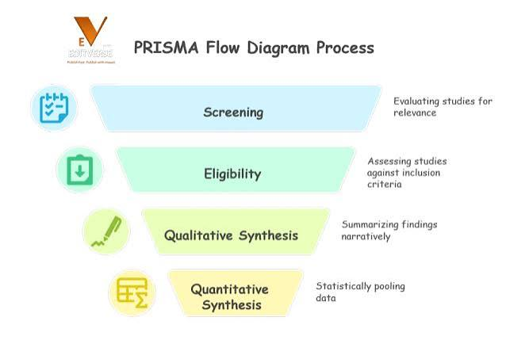
Methods
PEHR
UNIVERSITAS PENDIDIKAN INDONESIA
Physical Education, Health, and Recreation
Research method:
Systematic Literature Review (SLR) following the PRISMA 2020 guidelines
Chosen for its transparent, structured, replicable process → minimizes selection bias
Source: Page, et.al., 2021

Slide 5
PEHR
UNIVERSITAS PENDIDIKAN INDONESIA
Physical Education, Health, and Recreation
Result & Discussion
General study characteristic
Majority published 2021–2025; designs include experimental, quasi-experimental, classroom action research, R&D, descriptive-qualitative, and reviews
Population dominated by elementary school and early childhood students, followed by high schoolers and pre-service PE teachers
Studies from Indonesia, Spain, China, South Korea, etc. → a global concern
4 categories of GBL innovation:
Modified traditional games (engklek, gobak sodor, bentengan)
Tactical models (TGfU, Sport Education Model, small-sided games)
Digital gamification (points, badges, leaderboards)
AR/VR-based exergames

Slide 6
PEHR
UNIVERSITAS PENDIDIKAN INDONESIA
Physical Education, Health, and Recreation
Result & Discussion
Effect on motor skills | GBL consistently improves gross and fine motor skills as well as sport-specific technical-tactical skills; traditional games boost running/jumping/throwing; tactical models improve sport-specific skills; AR/VR improves coordination and balance (including for children with special needs)
Effect on learning motivation | Almost all studies report increased intrinsic and extrinsic motivation, explained through Self-Determination Theory (fulfillment of autonomy, competence, and relatedness needs)
Moderating factors | Teacher readiness/competence, facility and technology availability, student age characteristics, and intervention duration (significant motor effects require 8–12 weeks)

Slide 7
PEHR
Conclusion
UNIVERSITAS PENDIDIKAN INDONESIA
Physical Education, Health, and Recreation
  01. Various forms of GBL (modified traditional games, TGfU/small-sided games, digital gamification, AR/VR exergames) consistently show a positive impact on motor skills (gross, fine, technical-tactical)
  02. GBL also enhances learning motivation, both intrinsic (via autonomy, competence, relatedness) and extrinsic (via rewards/points)
  03. GBL's effectiveness is influenced by teacher readiness, facilities, student age, and intervention duration
  04. Recommendations: strengthen teacher training, develop culturally contextual GBL models, and conduct longer-term experimental research to strengthen causal evidence

Slide 8
PEHR
References
UNIVERSITAS PENDIDIKAN INDONESIA
Physical Education, Health, and Recreation
Page et al. (2021) — PRISMA 2020 Statement, BMJ
Camacho-Sánchez et al. (2023) — Game-based learning and gamification in PE, Education Sciences
Barba-Martín et al. (2020) — TGfU in PE, IJERPH
Ryan & Deci (2020) — Self-Determination Theory, Contemporary Educational Psychology
Sun & Chen (2024) — Sports game intervention on motor skills, Children
Chang et al. (2020) — AR in PE motor skills learning, Interactive Learning Environments
Komariah et al. (2024) — VR for cerebral palsy, Therapeutics and Clinical Risk Management

Slide 9
PEHR
UNIVERSITAS PENDIDIKAN INDONESIA
Physical Education, Health, and Recreation
Thank You!

