Slide 1








UNIVERSITAS PENDIDIKAN INDONESIA
PEHR
Physical Education, Health, and Recreation
STUDY PROGRAM
Faculty of Sport Education and Health
Relationship Between Mental Health and Physical Activity with Anxiety Levels Among Students of Al Arifin Islamic Boarding School
Zam Zam Nurjamil
Universitas Pendidikan Indonesia

Slide 2


UNIVERSITAS PENDIDIKAN INDONESIA
PEHR
Physical Education, Health, and Recreation
STUDY PROGRAM
Faculty of Sport Education and Health
INTRODUCTION
Mental health disorders and anxiety are common among adolescents. Islamic boarding school students face academic, religious, and social adaptation challenges. Physical activity may reduce anxiety and improve psychological well-being.

Slide 3
UNIVERSITAS PENDIDIKAN INDONESIA
PEHR
Physical Education, Health, and Recreation
STUDY PROGRAM
Faculty of Sport Education and Health
To examine the relationships between mental health, physical activity, and anxiety among students at Pesantren Al Arifin, and to determine the individual and combined contributions of mental health and physical activity to anxiety levels

Slide 4
METHOD
Quantitative correlational, cross-sectional design.
72 students.
Total sampling.
GHQ-12, GPAQ, GAD-7.
Multiple Linear Regression using SPSS 26.
UNIVERSITAS PENDIDIKAN INDONESIA
PEHR
Physical Education, Health, and Recreation
STUDY PROGRAM
Faculty of Sport Education and Health

Slide 5
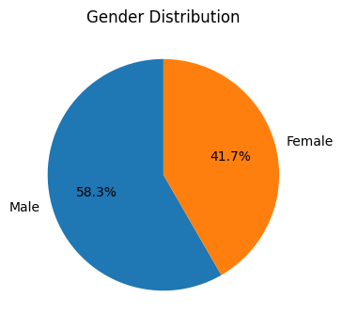
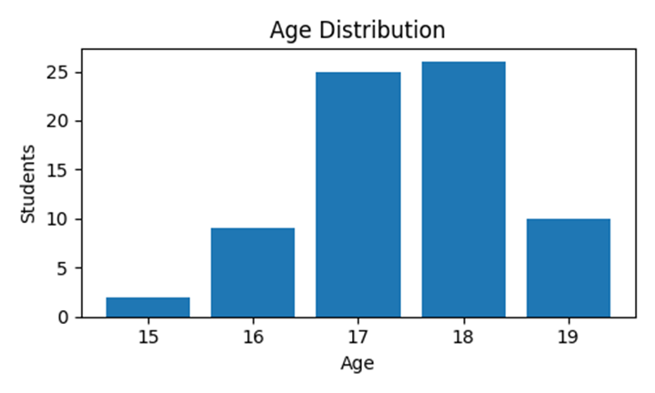
RESULT & DISCUSSION
Respondent characteristics:
UNIVERSITAS PENDIDIKAN INDONESIA
PEHR
Physical Education, Health, and Recreation
STUDY PROGRAM
Faculty of Sport Education and Health
Descriptive statistics:
Mental Health = 23.64 ± 4.98
Physical Activity = 2543.89 ± 1339.58 MET-min/week
Anxiety = 8.08 ± 4.48

Slide 6
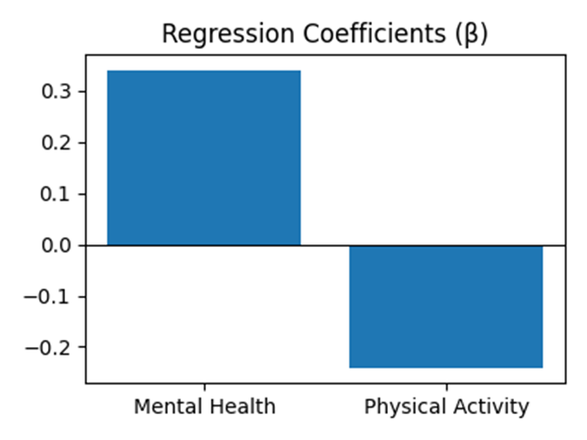
UNIVERSITAS PENDIDIKAN INDONESIA
PEHR
Physical Education, Health, and Recreation
STUDY PROGRAM
Faculty of Sport Education and Health
Mental Health: β=0.341 (p=0.003)
Physical Activity: β=-0.242 (p=0.035)
R²=0.233; F=10.505; p<0.001

Slide 7
CONCLUSION
Mental health was found to be significantly associated with higher anxiety levels, whereas higher physical activity was significantly associated with lower anxiety levels. Together, mental health and physical activity explained 23.3% of the variance in anxiety among students at Pesantren Al Arifin.
UNIVERSITAS PENDIDIKAN INDONESIA
PEHR
Physical Education, Health, and Recreation
STUDY PROGRAM
Faculty of Sport Education and Health

Slide 8
REFERENCES
UNIVERSITAS PENDIDIKAN INDONESIA
PEHR
Riskesdas (2018)
Hair et al. (2019)
Rahmawati & Supriyadi (2020)
Sari & Widodo (2020)
World Health Organization (2021)
Physical Education, Health, and Recreation
STUDY PROGRAM
Faculty of Sport Education and Health
Yusuf et al. (2021)
Kurniawan et al. (2022)
Karim & Hambali (2024)
Mufid & Ulinnuha (2024)
Putra et al. (2025)

