Slide 1








UNIVERSITAS PENDIDIKAN INDONESIA
PEHR
Physical Education, Health, and Recreation
STUDY PROGRAM
Faculty of Sport Education and Health
FIFA FITNESS TEST: ANALYSIS OF THE PHYSICAL CONDITION OF WOMEN FOOTBALL REFEREE
Syahrul Zulkifli
Universitas Pendidikan Indonesia

Slide 2


UNIVERSITAS PENDIDIKAN INDONESIA
PEHR
Intoduction
Physical Education, Health, and Recreation
STUDY PROGRAM
Faculty of Sport Education and Health
Referee are important in football matches
Referee needs a good speed and endurance
FIFA have a evaluation of a Physical Condition “Fitnees test” (RSA Test & Interval Test)
Many Referee in Indonesia still fail the Fitness Test.
There are only a few studies about female football referee.

Slide 3
UNIVERSITAS PENDIDIKAN INDONESIA
PEHR
Physical Education, Health, and Recreation
STUDY PROGRAM
INTRODUCTION
Faculty of Sport Education and Health
Research Problem?
What physical factors affect the success of female football referee in the FIFA Fitness Test?
Reseach Aim?
Research Aim to analyze physical condition of female football referee and identify the reasons for failing the FIFA Fitness Test.

Slide 4
UNIVERSITAS PENDIDIKAN INDONESIA
PEHR
Physical Education, Health, and Recreation
STUDY PROGRAM
METHODS
Faculty of Sport Education and Health
Cross-Sectional study
Six Female Referee (West Java)
Total Sampling
Test:
Repeated Sprint Ability
Interval Test
Data Analysis :
Shapiro-Wilk Test
Mann-Whithney U Test

Slide 5
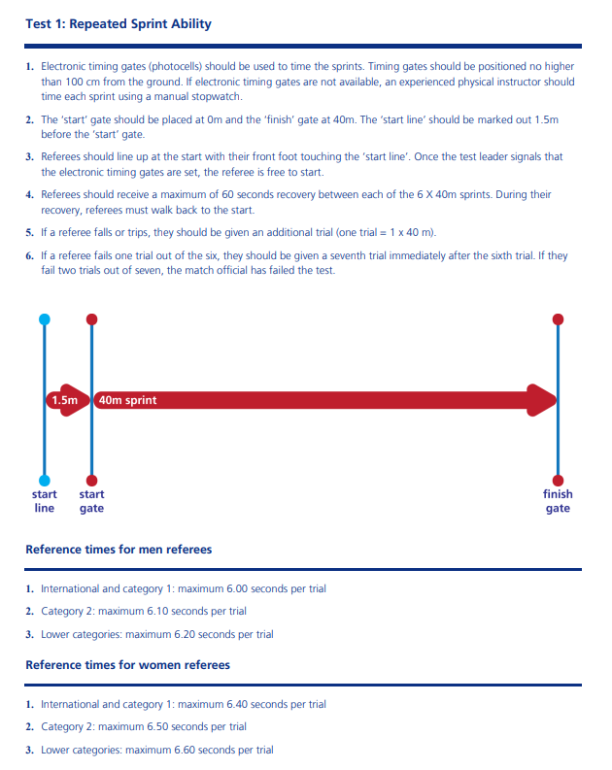
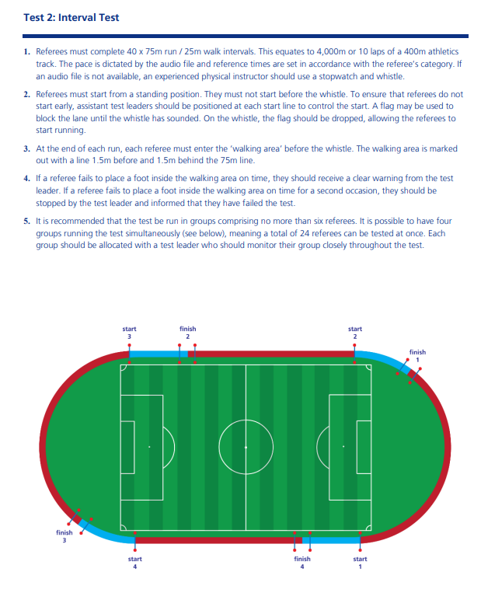
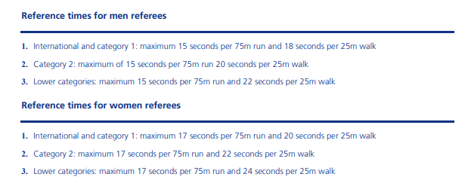
UNIVERSITAS PENDIDIKAN INDONESIA
METHODS
PEHR
Physical Education, Health, and Recreation
STUDY PROGRAM
Faculty of Sport Education and Health

Slide 6
UNIVERSITAS PENDIDIKAN INDONESIA
PEHR
Physical Education, Health, and Recreation
STUDY PROGRAM
RESULT
Faculty of Sport Education and Health
The fitness test results show that two people passed and four failed.
Failure occurred at the lowest test interval, specifically at 8 repetitions (800 Meters).

Slide 7
UNIVERSITAS PENDIDIKAN INDONESIA
PEHR
DISCUSSION
Physical Education, Health, and Recreation
STUDY PROGRAM
Faculty of Sport Education and Health
1
Majority of Referees Fail Interval Test.
Some female football referees in West Java have yet to meet the passing standards for fitness tests, as they are unable to complete the interval test, indicating that aerobic endurance is the primary issue (Sanchez-Garcia et al., 2018; Vigh-Larsen et al., 2024).
2
Aerobic and Anaerobic Capacity Are Important
Referees who passed achieved better RSA scores; however, success in the FIFA fitness test depends not only on maximal sprinting but also on maintaining a running rhythm through good aerobic capacity.
3
Speed Endurance is Important
The interplay between aerobic and anaerobic systems develops speed endurance—the ability to repeatedly maintain high speed. This is crucial because fitness tests and competitions are characterized by such demands.
4
Implications
The referee training program focuses on improving aerobic endurance, anaerobic capacity, and speed endurance through methods such as HIIT, Fartlek, or tempo runs.

Slide 8
UNIVERSITAS PENDIDIKAN INDONESIA
PEHR
Physical Education, Health, and Recreation
STUDY PROGRAM
CONCLUSION
Faculty of Sport Education and Health
Most Female referee did not pass the FIFA Fitness Test
The Interval test was the main reason for failure
Training should be focus on : Speed, Endurance and Speed endurance

Slide 9
REFERENCES
UNIVERSITAS PENDIDIKAN INDONESIA
PEHR
Physical Education, Health, and Recreation
STUDY PROGRAM
Faculty of Sport Education and Health
Ai, K., Oldrich, R., Tan, H., & Xu, P. (2020). Sustainable innovation in football referee training in Czech Republic. Sustainability (Switzerland), 12(7). https://doi.org/10.3390/su12072821
Berliana. (2011). Wanita dan Olahraga Prestasi. PT. Karya Manunggal Lithomas.
Bradley, P. S., Dellal, A., Mohr, M., Castellano, J., & Wilkie, A. (2014). Gender differences in match performance characteristics of soccer players competing in the UEFA Champions League. Human Movement Science, 33(1), 159–171. https://doi.org/10.1016/j.humov.2013.07.024
Buchheit, M., & Laursen, P. B. (2013). High-intensity interval training, solutions to the programming puzzle: Part I: Cardiopulmonary emphasis. Sports Medicine, 43(5), 313–338. https://doi.org/10.1007/s40279-013-0029-x
Burhaeın, E., Ndayisenga, J., Lourenço, C. C. V., & Bangurambona, F. (2024). Enhancing Untrained Football Referees’ Strength, Speed, and Endurance through A Mix-training Programme. International Journal of Disabilities Sports and Health Sciences, 7(6), 1282–1289. https://doi.org/10.33438/ijdshs.1521395
Castillo-Rodríguez, A., Caparrós, J. L. R., Figueiredo, A., González-Fernández, F. T., & Onetti-Onetti, W. (2023). Cause-Effect: The Relationship between Role and Experience with Psychological and Physical Responses in the Competition Context in Soccer Referees. Journal of Human Kinetics , 89(October), 289–300. https://doi.org/10.5114/jhk/169174
Datson, N., Hulton, A., Andersson, H., Lewis, T., Weston, M., Drust, B., & Gregson, W. (2014). Applied physiology of female soccer: An update. Sports Medicine, 44(9), 1225–1240. https://doi.org/10.1007/s40279-014-0199-1
Destrian, O., Sumartias, S., Setiawan, W., & Board, E. (2022). Women in " Masculine " Sports : Self-Concept Female Referee in Football. Journal of Positive School Psychology, 6(8), 8966–8978.
Eratli Şirin, Y., & ÖZ, G. (2024). Women football observers’ experiences: a perspective from system justification and glass ceiling. Frontiers in Psychology, 15(November). https://doi.org/10.3389/fpsyg.2024.1495843
FIFA. (2020). Refereeing Fitness Tests.
Gary P. McEwan, & Unnithan, V. B. (2024). Decision‐making accuracy of soccer referees in relation tomarkers of internal and external load.pdf. EUROPEAN JOURNAL OF SPORT SCIENCE away.
Gomes, R., Mendes, R., Ferreira, A., Mendes, R., Dias, G., & Martins, F. (2024). Physical and Physiological Demands of Amateur Portuguese Field and Assistant Football Referees. Sports, 12(5), 1–9. https://doi.org/10.3390/sports12050133
Helgerud, J., Høydal, K., Wang, E., Karlsen, T., Berg, P., Bjerkaas, M., Simonsen, T., Helgesen, C., Hjorth, N., Bach, R., & Hoff, J. (2007). Aerobic high-intensity intervals improve V̇O2max more than moderate training. Medicine and Science in Sports and Exercise, 39(4), 665–671. https://doi.org/10.1249/mss.0b013e3180304570
Hussein, M. G. (2024). The Effect of Special Fartlek Style Exercises in Developing the Speed Endurance of First-Class Football Referees. Pubmedia Jurnal Pendidikan Olahraga, 1(4), 8. https://doi.org/10.47134/jpo.v1i4.656
Iaia, F. M., & Bangsbo, J. (2010). Speed endurance training is a powerful stimulus for physiological adaptations and performance improvements of athletes. Scandinavian Journal of Medicine and Science in Sports, 20(SUPPL. 2), 11–23. https://doi.org/10.1111/j.1600-0838.2010.01193.x
Krustrup, P., Helsen, W., Randers, M. B., Christensen, J. F., MacDonald, C., Rebelo, A. N., & Bangsbo, J. (2009). Activity profile and physical demands of football referees and assistant referees in international games. Journal of Sports Sciences, 27(11), 1167–1176. https://doi.org/10.1080/02640410903220310
Martinez-Torremocha, G., Alonso-Callejo, A., Sanchez-Sanchez, J., Garcia-Unanue, J., Gallardo, L., Martin-Sanchez, M. L., Serrano, C., & Felipe, J. L. (2025). How do gender and competition level influence the physical demands in worst-case scenarios of elite football referees? BMC Sports Science, Medicine and Rehabilitation, 17(1). https://doi.org/10.1186/s13102-025-01282-4
Nurcahya, Y., & Nurmansyah Awwaludin, P. (2020). Hubungan Antara Kebugaran Jasmani Dengan Kinerja Wasit Sepakbola. Jurnal Sains Keolahragaan Dan Kesehatan, 5(1), 1–8. https://doi.org/10.5614/jskk.2020.5.1.1
Rampinini, E., Sassi, A., Morelli, A., Mazzoni, S., Fanchini, M., & Coutts, A. J. (2009). Repeated-sprint ability in professional and amateur soccer players. Applied Physiology, Nutrition and Metabolism, 34(6), 1048–1054. https://doi.org/10.1139/H09-111
Sánchez-García, M., Sánchez-Sánchez, J., Rodríguez-Fernández, A., Solano, D., & Castillo, D. (2018). Relationships between sprint ability and endurance capacity in soccer referees. Sports, 6(2), 8–12. https://doi.org/10.3390/sports6020028
Sánchez, M. L. M., Oliva-Lozano, J. M., García-Unanue, J., Krustrup, P., Felipe, J. L., Moreno-Pérez, V., Gallardo, L., & Sánchez-Sánchez, J. (2022). Association between Fitness Level and Physical Match Demands of Professional Female Football Referees. International Journal of Environmental Research and Public Health, 19(17). https://doi.org/10.3390/ijerph191710720
Sandford, G. N., Laursen, P. B., & Buchheit, M. (2021). Anaerobic Speed/Power Reserve and Sport Performance: Scientific Basis, Current Applications and Future Directions. Sports Medicine, 51(10), 2017–2028. https://doi.org/10.1007/s40279-021-01523-9
Sasongko, B. D., Supriatna, S., Fadhli, N. R., & Roesdiyanto, R. (2023). Tingkat Physical Fitness Wasit Futsal di Persatuan Sepakbola Seluruh Indonesia (PSSI) Kota Palu. Sport Science and Health, 5(1), 1–6. https://doi.org/10.17977/um062v5i12023p1-6
Suárez-Iglesias, D., Rodríguez-Fernández, A., Vaquera, A., Villa-Vicente, J. G., & Rodríguez-Marroyo, J. A. (2024). Comparative Effects of Two High-Intensity Intermittent Training Programs on Sub-Elite Male Basketball Referees’ Fitness Levels. Sports, 12(2), 1–12. https://doi.org/10.3390/sports12020051
Syamsudar, B., & Nurcahya, Y. (2023). Physical Activity of Referees and Assistant Referees at Indonesian Football League 2019/2020. International Journal of Artificial Intelligence …, January. https://doi.org/10.29099/ijair.v6i1.2.456
Vigh-Larsen, J. F., Junge, N., Cialdella-Kam, L., Tomás, R., Young, L., Krustrup, P., Mohr, M., & Nybo, L. (2024). Testing in Intermittent Sports - Importance for Training and Performance Optimization in Adult Athletes. In Medicine and Science in Sports and Exercise (Vol. 56, Issue 8). https://doi.org/10.1249/MSS.0000000000003442
Weston, M., Castagna, C., Impellizzeri, F. M., Bizzini, M., Williams, A. M., & Gregson, W. (2012). Science and medicine applied to soccer refereeing: An update. Sports Medicine, 42(7), 615–631. https://doi.org/10.2165/11632360-000000000-00000
Zulkifli, S., & Syamsudar, B. (2025). Physical Condition Level and Survey of the West Java PSSI Referee Training Program. Jp.Jok (Jurnal Pendidikan Jasmani, Olahraga Dan Kesehatan), 9(1), 23–38. https://doi.org/https://doi.org/10.33503/jp.jok.v9i1.2127

