Slide 1


PEHR
UNIVERSITAS PENDIDIKAN INDONESIA
Physical Education, Health, and Recreation
STUDY PROGRAM
Faculty of Sport Education and Health
Analysis the Proportion and Representation of Female Coaches at The Regional Level
Dian Dianti
Indonesia University of Education

Slide 2







PEHR
UNIVERSITAS PENDIDIKAN INDONESIA
Physical Education, Health, and Recreation
STUDY PROGRAM
Faculty of Sport Education and Health
Background
Despite increasing female participation in sport, coaching remains male-dominated.
Coaches are essential in athlete development and sport leadership.
Previous studies show persistent gender inequality in coaching.
Most evidence comes from elite sport and Western countries.
Evidence from regional sport systems in Indonesia is still limited.

Slide 3
PEHR
UNIVERSITAS PENDIDIKAN INDONESIA
Physical Education, Health, and Recreation
STUDY PROGRAM
Faculty of Sport Education and Health
Research Gap & Objective
Previous studies rarely analyze both the proportion of female coaches and their representation in leadership positions.
Few studies examine female coach representation at the regional level in Indonesia.
⁠This study aims to analyze:
⁠the proportion of licensed female basketball coaches in West Java; and
⁠the representation of female coaches as head coaches in the 2025 KEJURDA.

Slide 4
PEHR
UNIVERSITAS PENDIDIKAN INDONESIA
Physical Education, Health, and Recreation
Methods
STUDY PROGRAM
Faculty of Sport Education and Health
Research Design
Data Sources
Quantitative Descriptive
⁠PERBASI West Jawa Coaching Database
KEJURDA 2025 Coaching Roaster
Population & Sampling
Analysis
818 Licensed Coaches
26 Regencies/cities
Total Sampling
⁠Frequency
Percentage
Descriptive Statistics

Slide 5
Results
Proportion of Coaches
PEHR
UNIVERSITAS PENDIDIKAN INDONESIA
Physical Education, Health, and Recreation
STUDY PROGRAM
Faculty of Sport Education and Health
Total Coaches: 818
Male: 678 (83%)
Female: 140 (17%)
⁠Female coaches represent only 17% of licensed coaches.
Bandung City has the highest number of female coaches.
Female coach distribution varies across regions.

Slide 6
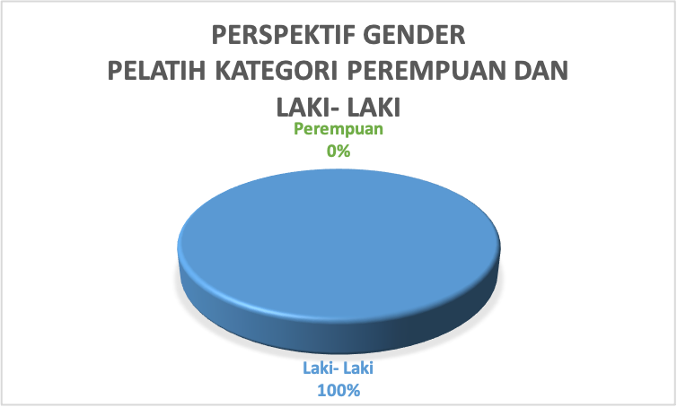
Results
Leadership Representation
PEHR
UNIVERSITAS PENDIDIKAN INDONESIA
Physical Education, Health, and Recreation
STUDY PROGRAM
Faculty of Sport Education and Health
⁠100% of heas coaches were male
No. female coach served as head coach in either division during the 2025 KEJURDA

Slide 7
PEHR
UNIVERSITAS PENDIDIKAN INDONESIA
Physical Education, Health, and Recreation
STUDY PROGRAM
Discussion & Conclusion
Faculty of Sport Education and Health
Discussion
Conslucion
•⁠ ⁠Gender inequality exists in both participation and leadership.
•⁠ ⁠Female coaches remain underrepresented in strategic coaching positions.
•⁠ ⁠Findings are consistent with Burton (2015), LaVoi & Dutove (2012), and Norman (2010).
⁠•⁠ ⁠Women account for only 17% of licensed basketball coaches.
•⁠ ⁠Female representation as head coaches remains 0%.
•⁠ ⁠Gender-responsive recruitment, mentoring, and leadership development are needed.

Slide 8
PEHR
UNIVERSITAS PENDIDIKAN INDONESIA
Physical Education, Health, and Recreation
STUDY PROGRAM
Faculty of Sport Education and Health
References
⁠
Acosta, R. V., & Carpenter, L. J. (2014).Adriaanse, J. (2016).
Berliana. (2011).
Burton, L. J. (2015).
Claringbould, I., & Knoppers, A. (2012).
Evans, A. B., & Pfister, G. U. (2021).
LaVoi, N. M. (2016).
LaVoi, N. M., & Dutove, J. K. (2012).
Norman, L. (2010).
PERBASI Jawa Barat. (2025).
Sotiriadou, P., & de Haan, D. (2019).

Slide 9
PEHR
UNIVERSITAS PENDIDIKAN INDONESIA
Physical Education, Health, and Recreation
STUDY PROGRAM
Faculty of Sport Education and Health
⁠
THANK YOU

