Slide 1








UNIVERSITAS PENDIDIKAN INDONESIA
PEHR
Physical Education, Health, and Recreation
STUDY PROGRAM
Faculty of Sport Education and Health
The Effect of Combined Basketball Training and Continuous Running on Cardiovascular Endurance
Lhaoera Wiendhary
Universitas Pendidikan Indonesia

Slide 2


UNIVERSITAS PENDIDIKAN INDONESIA
PEHR
Physical Education, Health, and Recreation
STUDY PROGRAM
Faculty of Sport Education and Health
INTRODUCTION
Background
Cardiovascular endurance is a fundamental component of physical fitness that supports students' health, learning activities, and sports performance. However, the increasing prevalence of sedentary lifestyles among adolescents has contributed to declining cardiovascular fitness, highlighting the need for more effective school-based training programs. Basketball is one of the most popular extracurricular sports in junior high schools; however, conventional basketball training may not provide sufficient continuous aerobic stimulation to maximize cardiovascular endurance. Therefore, integrating basketball training with Continuous Run is expected to provide greater improvements in cardiovascular endurance than conventional basketball training alone.
Research Objective
This study aimed to examine the effect of combining basketball training with Continuous Run on improving cardiovascular endurance among junior high school students participating in basketball extracurricular activities at SMP Negeri 1 Jalaksana and to compare its effectiveness with conventional basketball training.

Slide 3
UNIVERSITAS PENDIDIKAN INDONESIA
PEHR
Physical Education, Health, and Recreation
STUDY PROGRAM
Faculty of Sport Education and Health
INTRODUCTION
Research Gap
Previous studies have demonstrated that basketball training improves aerobic capacity and cardiovascular endurance, while Continuous Run effectively enhances VO₂max and aerobic fitness. However, most previous research has investigated these training methods separately or compared different exercise models. In addition, existing studies have primarily involved athletes, university students, or adult participants, with limited research focusing on junior high school students participating in school extracurricular sports. Therefore, this study evaluates the effectiveness of integrating basketball training and Continuous Run within a structured training program and compares it with conventional basketball training to determine whether the combined approach produces greater improvements in cardiovascular endurance.

Slide 4
UNIVERSITAS PENDIDIKAN INDONESIA
PEHR
Physical Education, Health, and Recreation
STUDY PROGRAM
Faculty of Sport Education and Health
METHOD
This study employed a quantitative approach using a quasi-experimental design with a pretest–posttest control group design. The study involved 30 students aged 12–13 years who participated in the basketball extracurricular program at SMP Negeri 1 Jalaksana. Participants were selected using purposive sampling based on predetermined inclusion criteria and were randomly assigned to an experimental group (n = 15) and a control group (n = 15).
The experimental group received a combination of basketball training and Continuous Run, whereas the control group participated in conventional basketball training only. The intervention was conducted over four weeks, with four training sessions per week. Cardiovascular endurance was assessed using the 20-Meter Shuttle Run Test (Pacer Test), a standardized field test used to estimate maximal oxygen uptake (VO₂max). Data were analyzed using IBM SPSS Statistics version 27. Descriptive statistics were used to summarize participant characteristics and research findings. Before hypothesis testing, data normality was examined using the Shapiro–Wilk test, and homogeneity of variance was assessed using Levene's test. Differences between pretest and posttest scores within each group were analyzed using paired-sample t-tests, while posttest differences between the experimental and control groups were analyzed using an independent-sample t-test. Statistical significance was established at p < 0.05.

Slide 5
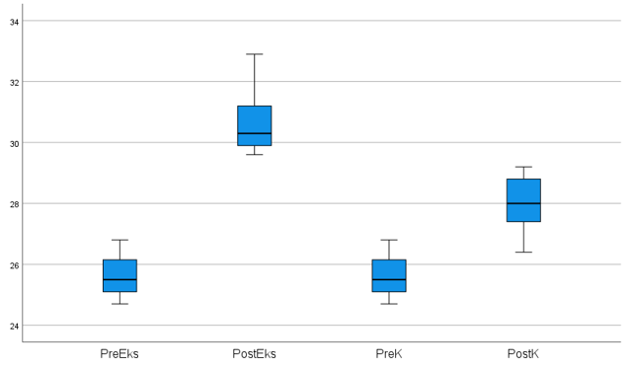
UNIVERSITAS PENDIDIKAN INDONESIA
PEHR
Physical Education, Health, and Recreation
STUDY PROGRAM
Faculty of Sport Education and Health
RESULT
The descriptive analysis showed that both groups experienced improvements in cardiovascular endurance after the intervention. However, the experimental group demonstrated greater improvement than the control group. The experimental group improved by 4.99 points (19.43%), while the control group improved by 2.34 points (9.11%). Statistical analysis also confirmed significant differences between pretest and posttest scores in both groups, as well as significant differences between the posttest scores of the experimental and control groups.

Slide 6
UNIVERSITAS PENDIDIKAN INDONESIA
PEHR
Physical Education, Health, and Recreation
STUDY PROGRAM
Faculty of Sport Education and Health
DISCUSSION
The findings of this study indicate that combining basketball training with Continuous Run is more effective than conventional basketball training in improving cardiovascular endurance among junior high school students. Basketball training develops sport-specific movement patterns through repeated sprinting, jumping, and rapid changes of direction, whereas Continuous Run enhances aerobic capacity, oxygen transport, stroke volume, and VO₂max. The integration of these two training methods produces complementary physiological adaptations that result in greater improvements in cardiovascular endurance. These findings are consistent with previous studies reporting that continuous aerobic exercise effectively improves cardiorespiratory fitness and that basketball training enhances aerobic performance. Unlike previous research that investigated each training method separately, this study demonstrates that integrating basketball training with Continuous Run within a structured extracurricular program provides additional physiological benefits and represents a practical training strategy for improving students' cardiovascular fitness.

Slide 7
UNIVERSITAS PENDIDIKAN INDONESIA
PEHR
Physical Education, Health, and Recreation
STUDY PROGRAM
Faculty of Sport Education and Health
CONCLUSION
This study concludes that the combination of basketball training and Continuous Run is more effective than conventional basketball training in improving cardiovascular endurance among junior high school students participating in basketball extracurricular activities. Although both training programs significantly improved cardiovascular endurance, the experimental group demonstrated greater improvement than the control group, indicating that integrating basketball training with Continuous Run provides additional physiological benefits. Therefore, this combined training program can be recommended as an effective and practical exercise model for school-based extracurricular sports activities to enhance students' cardiovascular fitness

Slide 8
UNIVERSITAS PENDIDIKAN INDONESIA
PEHR
Physical Education, Health, and Recreation
STUDY PROGRAM
Faculty of Sport Education and Health
REFERENCES
Fajriyudin, M., Aminudin, R., & Fahrudin, F. (2021). Pengaruh metode continuous running terhadap peningkatan daya tahan siswa ekstrakurikuler pencak silat di Pondok Pesantren Modern Nurussalam. Jurnal Literasi Olahraga, 2(1), 51–59.
Franklin, B. A., Eijsvogels, T. M. H., Pandey, A., Quindry, J., & Toth, P. P. (2022). Physical activity, cardiorespiratory fitness, and cardiovascular health: A clinical practice statement of the ASPC. American Journal of Preventive Cardiology, 12, 100424.
Guthold, R., Stevens, G. A., Riley, L. M., & Bull, F. C. (2020). Global trends in insufficient physical activity among adolescents. The Lancet Child & Adolescent Health, 4(1), 23–35.
Montgomery, P. G., Pyne, D. B., & Minahan, C. L. (2010). The physical and physiological demands of basketball training and competition. International Journal of Sports Physiology and Performance, 5(1), 75–86.
Shalom, A., Gottlieb, R., Alcaraz, P. E., & Calleja-Gonzalez, J. (2023). A narrative review of the dominant physiological energy systems in basketball and the importance of specificity. Applied Sciences, 13(23).

