Slide 1


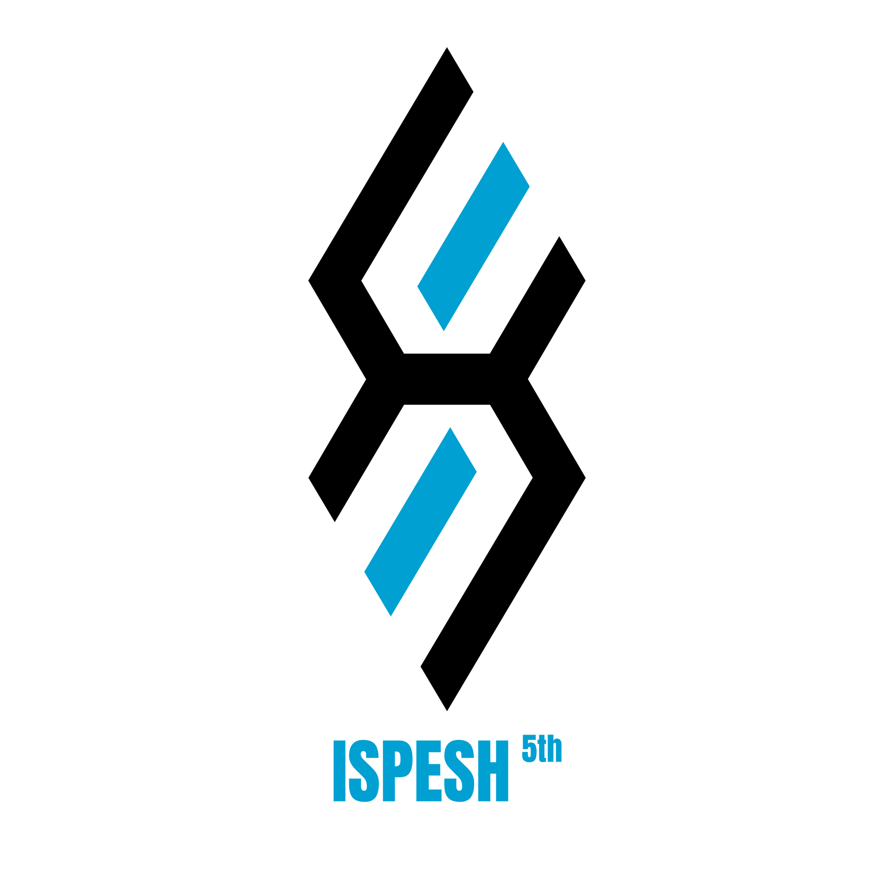





UNIVERSITAS PENDIDIKAN INDONESIA
PEHR
Physical Education, Health, and Recreation
STUDY PROGRAM
Faculty of Sport Education and Health
The Effects of Ramadan Fasting on Athletic Performance: A Literature Review
Muhammad Yusuf Abdillah
Universitas Pendidikan Indonesia

Slide 2


UNIVERSITAS PENDIDIKAN INDONESIA
PEHR
Physical Education, Health, and Recreation
STUDY PROGRAM
Faculty of Sport Education and Health
Introduction
Fasting, particularly during the Islamic month of Ramadan, is an act of worship involving abstinence from food and drink from dawn until sunset with the intention of enhancing spirituality, self-control, and empathy toward others (Shephard, 2013). Sport and physical training are likewise encouraged in Islam as means of maintaining health and bodily fitness, provided they do not violate Islamic law or endanger one's health (Winartin et al., 2023; Khan Asif Ali Salahuddin Khan Naveed Yazdani et al., 2020). When performed at the right time and manner, sport can help preserve body endurance during fasting while also supporting social, mental, and emotional well-being (Trabelsi et al., 2018; Maughan, 2010).

Slide 3
UNIVERSITAS PENDIDIKAN INDONESIA
Introduction
PEHR
Physical Education, Health, and Recreation
STUDY PROGRAM
Faculty of Sport Education and Health
Training is a systematic process involving a gradual increase in intensity, duration, and frequency to achieve specific physical or performance goals (Fisher & Csapo, 2021; Shephard, 2013), and in Islam, maintaining health through such training is considered important as it supports the optimal execution of worship (Mahmoud Al Ali & Mahmoud Al Zitawi, 2024). Exercising while fasting is permissible provided it does not cause excessive fatigue or harm one's health, with the late afternoon—close to breaking the fast—regarded as the optimal time for training, as it minimizes dehydration risk while supporting physical performance (Chamari et al., 2019). Since the body relies on glycogen and fat reserves during fasting, strategic adjustments in training intensity and scheduling, such as exercising after breaking the fast, are recommended to preserve both performance and health (Mandal et al., 2022; Pejenaute-Larráyoz et al., 2025; Maughan & Shirreffs, 2012).

Slide 4
UNIVERSITAS PENDIDIKAN INDONESIA
Methods
PEHR
Physical Education, Health, and Recreation
STUDY PROGRAM
Faculty of Sport Education and Health
This study employed a Systematic Literature Review (SLR) approach to collect, evaluate, and synthesize relevant literature on the physiological impacts of Ramadan fasting on sports performance, chosen for its rigor, transparency, and replicability in minimizing researcher bias (Snyder, 2019; Priharsari, 2022). The process began with a comprehensive literature search across Scopus, PubMed, Google Scholar, and Semantic Scholar using targeted keywords such as "Ramadan Fasting," "Athletic Performance," "Hydration," and "Sports Training," followed by a strict selection of original research and primary literature reviews based on predefined inclusion and exclusion criteria to ensure empirical validity. The selected articles were then extracted into a structured analysis matrix, enabling the synthesis of research outcomes, identification of research gaps, and formulation of practical contributions to help coaches and athletes optimize performance and hydration status during Ramadan.

Slide 5
UNIVERSITAS PENDIDIKAN INDONESIA
Result & Discussion
Physiological & Recovery Effects
PEHR
Physical Education, Health, and Recreation
STUDY PROGRAM
Faculty of Sport Education and Health
Chamari & Briki (2025): Ramadan fasting causes hypohydration and sleep disturbances; performance is best preserved through individualized training schedules (before/after Iftar, after Suhoor) and proper hydration strategies.
Burke & King (2012): Delayed nutrient timing during fasting impairs training adaptation and recovery; shifting exercise to post-Iftar hours helps meet carbohydrate and protein needs.
Elsahoryi et al. (2025): Fasting significantly reduces sleep quality and physical activity levels, but improves body composition (weight, BMI, fat mass) with no adverse mental health effects.
Fenni et al. (2025): Soccer players show declines in jump, sprint, and strength performance with increased muscle damage markers, yet overall recovery remains manageable with proper adjustments.

Slide 6
Conclusion
UNIVERSITAS PENDIDIKAN INDONESIA
PEHR
Physical Education, Health, and Recreation
STUDY PROGRAM
Faculty of Sport Education and Health
Ramadan fasting has varied effects on athletic performance, depending on the sport type and adaptation strategies applied.
Explosive & sprint performance (power, jump, technical skills) tend to decline, while aerobic capacity, strength, and endurance generally remain stable.
Sleep disruption and dehydration are the most consistent challenges across studies, but are manageable through proper hydration and rest strategies.
Training timing—especially sessions after Iftar—combined with strategic nutrition, helps athletes minimize negative impacts of fasting.
Fasting also offers positive physiological benefits, such as reduced body fat and improved cardiometabolic markers.
With well-designed training programs, athletes can maintain performance while continuing to observe Ramadan fasting.
Further research is needed on elite athletes to optimize training strategies during Ramadan.

Slide 7
References
UNIVERSITAS PENDIDIKAN INDONESIA
PEHR
Physical Education, Health, and Recreation
STUDY PROGRAM
Faculty of Sport Education and Health
Abaïdia, A. E., Daab, W., & Bouzid, M. A. (2020). Effects of Ramadan Fasting on Physical Performance: A Systematic Review with Meta-analysis. In Sports Medicine (Vol. 50, Number 5, pp. 1009–1026). Springer. https://doi.org/10.1007/s40279-020-01257-0
Brini, S., Castillo, D., Raya-González, J., Castagna, C., Bouassida, A., Khalifa, R., Chortane, S. G., & Clemente, F. M. (2021). Basketball-specific small-sided games training during ramadan intermitting fasting: Do changes in body composition, sleep habits, and perceived exertion affect technical performance? International Journal of Environmental Research and Public Health, 18(22). https://doi.org/10.3390/ijerph182212008
Burke, L. M., & King, C. (2012). Ramadan fasting and the goals of sports nutrition around exercise. Journal of Sports Sciences, 30(SUPPL.1). https://doi.org/10.1080/02640414.2012.680484
Chamari, K., & Briki, W. (2025). Training and competing during Ramadan–Practical recommendations for athletes and coaches. Tunisie Medicale, 103(7), 868–876. https://doi.org/10.62438/tunismed.v103i7.5757
Chamari, K., Roussi, M., Bragazzi, N., Chaouachi, A., & Rashid Aziz, A. (2019). Optimizing training and competition during the month of Ramadan: Recommendations for a holistic and personalized approach for the fasting athletes Optimisation de l’entraînement et des compétitions pendant le mois de Ramadan pour les athlètes jeûneurs: Recommandations pratiques. In LA TUNISIE MEDICALE (Vol. 97, Number 10).
Elsahoryi, N. A., Ibrahim, M. O., Alhaj, O. A., Abu Doleh, G., & Aljahdali, A. A. (2025). Impact of Ramadan Fasting on Mental Health, Body Composition, Physical Activity, and Sleep Outcomes Among University Students. Healthcare (Switzerland), 13(6). https://doi.org/10.3390/healthcare13060639

Slide 8
References
UNIVERSITAS PENDIDIKAN INDONESIA
PEHR
Physical Education, Health, and Recreation
STUDY PROGRAM
Faculty of Sport Education and Health
Fenni, Y., Ikiouane, M., Redjal, M., Remini, H., Allam, A., & Zaabar, S. (2025). The effects of Ramadan fasting on various physiological and biochemical parameters on Muslim soccer players. In Apunts Sports Medicine (Vol. 60, Number 225). Generalitat de Catalunya, Department de la Presidencia, Secretaria General de l Esport. https://doi.org/10.1016/j.apunsm.2024.100467
Fisher, J. P., & Csapo, R. (2021). Periodization and Programming in Sports. In Sports (Vol. 9, Number 2). MDPI. https://doi.org/10.3390/sports9020013
Guembri, M. A., Racil, G., Tounsi, M., Aouichaoui, C., Russo, L., Migliaccio, G. M., Trabelsi, Y., Souissi, N., & Padulo, J. (2024). Effects of Ramadan Fasting on Sleep and Physical Fitness among Young Female Handball Players. Children, 11(8). https://doi.org/10.3390/children11080954
Khan Asif Ali Salahuddin Khan Naveed Yazdani, W., Asif Ali, W., Khan, S., & Yazdani, N. (2020). Islamic Perspective Regarding the Promotion of Health and Participation in Sports Activities. Journal of Islamic Thought and Civilization (JITC), 10(1), 2520–0313. https://doi.org/10.32350/jitc
Mahmoud Al Ali, J. A. R., & Mahmoud Al Zitawi, D. U. D. D. (2024). The Role of Physical Education in Promoting Islamic Values. International Journal of Academic Research in Progressive Education and Development, 13(3). https://doi.org/10.6007/ijarped/v13-i3/22590
Mandal, S., Simmons, N., Awan, S., Chamari, K., & Ahmed, I. (2022). Intermittent fasting: Eating by the clock for health and exercise performance. BMJ Open Sport and Exercise Medicine, 8(1). https://doi.org/10.1136/bmjsem-2021-001206
Maughan, R. J., & Shirreffs, S. M. (2012). Hydration and performance during Ramadan. Journal of Sports Sciences, 30(SUPPL.1). https://doi.org/10.1080/02640414.2012.688140

Slide 9
UNIVERSITAS PENDIDIKAN INDONESIA
PEHR
Physical Education, Health, and Recreation
STUDY PROGRAM
References
Faculty of Sport Education and Health
Pejenaute-Larráyoz, D., Corbi, F., & Matas, S. (2025). Effects of intermittent fasting and sports performance – A narrative review. In Nutricion Hospitalaria (Vol. 42, Number 1, pp. 153–160). ARAN Ediciones S.L. https://doi.org/10.20960/nh.05415
Priharsari, D. (2022). SYSTEMATIC LITERATURE REVIEW DI BIDANG SISTEM INFORMASI DAN ILMU KOMPUTER. 9(2), 263–268. https://doi.org/10.25126/jtiik.202293884
Said, I. (2023). Sport During the Ramadan Fasting Period: Health Benefits and Risks and Recommendations for Practicing. International Journal of Sport Studies for Health, 6(1). https://doi.org/10.5812/intjssh-136775
Snyder, H. (2019). Literature review as a research methodology: An overview and guidelines. Journal of Business Research, 104, 333–339. https://doi.org/10.1016/j.jbusres.2019.07.039
Trabelsi, K., Moalla, W., Boukhris, O., Ammar, A., Elabed, K., Hakim, A., & Chtourou, H. (2018). Effects of Practicing Physical Activity During Ramadan Fasting on Health-Related Indices: An Updated Brief Review. International Journal of Sport Studies for Health, In Press(In Press). https://doi.org/10.5812/intjssh.83789
Winartin, S., Widiyanto, W., Manihuruk, F., & Manihuruk, P. K. A. (2023). The Role of Sport in Improving Physical Health and Fitness: A Literature Study. International Journal of Multidisciplinary Research and Analysis, 06(03). https://doi.org/10.47191/ijmra/v6-i3-18

Slide 10
UNIVERSITAS PENDIDIKAN INDONESIA
PEHR
Physical Education, Health, and Recreation
STUDY PROGRAM
Faculty of Sport Education and Health
Thank You
Muhammad Yusuf Abdillah
Universitas Pendidikan Indonesia

