Slide 1








UNIVERSITAS PENDIDIKAN INDONESIA
PEHR
Physical Education, Health, and Recreation
STUDY PROGRAM
Faculty of Sport Education and Health
The Effect of the Teaching Game for Understanding on Social Skill Outcomes and Futsal Playing Performance at SMPN 18 Bandung
THAIFUR RAHMAN
Physical Education Health and Recreation
Notes:
Good morning/afternoon, everyone. Thank you for the opportunity to present my research. My name is Hizba Azka, from the Physical Education, Health, and Recreation Study Program, Faculty of Sport Education and Health, Universitas Pendidikan Indonesia. Today I will present my study titled "The Effect of the Teaching Game for Understanding on Social Skill Outcomes and Futsal Playing Performance at SMPN 18 Bandung" a comparative study conducted at SMPN 18 Bandung, Indonesia.

Slide 2


UNIVERSITAS PENDIDIKAN INDONESIA
PEHR
Physical Education, Health, and Recreation
STUDY PROGRAM
Faculty of Sport Education and Health
Background
Problem: A learning approach is needed that can simultaneously enhance social interaction and futsal performance.
TGfU (Teaching Games for Understanding): a tactical approach that emphasizes game understanding through direct experience.
Notes:
Let me begin with the background of this study. I observed that the students' skills particularly in futsal at SMPN 18 Bandung vary different.
Consequently, disparities in both playing ability and social skills became apparent during instruction.
Thats why, I undertook this study to determine whether the TGfU (Teaching Games for Understanding) approach could effectively address these issues.

Slide 3
UNIVERSITAS PENDIDIKAN INDONESIA
PEHR
Physical Education, Health, and Recreation
STUDY PROGRAM
Faculty of Sport Education and Health
Research Design and Instruments
Quantitative experiment, pretest, posttest control group design
30 students from Class VIII-D, SMPN 18 Bandung
Experimental group (n=15, TGfU) and control group (n=15)
Purposive sampling
INSTRUMENTS : Game Performance Assessment Instrument (GPAI) & Social Skills Rating Scale (SSRS)
Notes:
Research Design
The research design employs a quantitative experimental approach—specifically a pretest-posttest control group design—
involving 30 students from class VIII-D,
who were divided into two groups: an experimental group of 15 students and a control group of 15 students.
two instruments were tested for validity and reliability before to use.

Slide 4
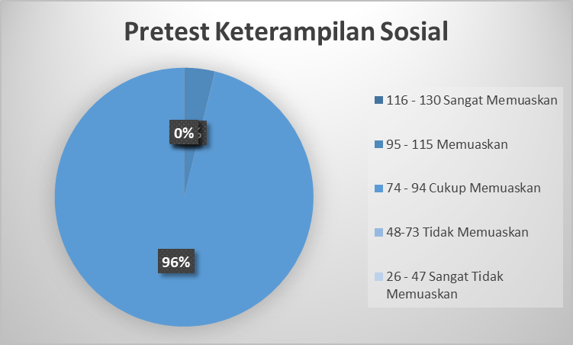
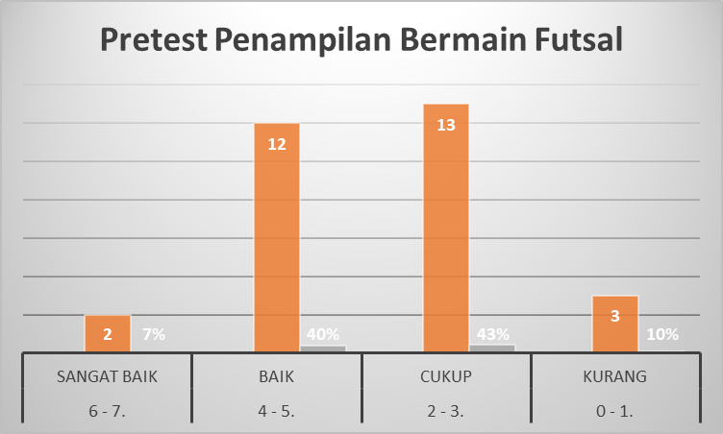
UNIVERSITAS PENDIDIKAN INDONESIA
PEHR
Physical Education, Health, and Recreation
STUDY PROGRAM
Faculty of Sport Education and Health
Pretest Findings
Notes:
Based on the pretest results, 96% of the students demonstrated satisfactory social skills, indicating that their social competence was generally good. However, futsal game performance was mainly categorized as fair (43%) and good (40%), suggesting that students' playing performance still needs improvement. Therefore, the Tactical Approach is expected to enhance both students' social skills and futsal game performance.

Slide 5
UNIVERSITAS PENDIDIKAN INDONESIA
PEHR
Physical Education, Health, and Recreation
STUDY PROGRAM
Faculty of Sport Education and Health
Conclusion & Implications
1. TGfU-based instruction is needed to simultaneously enhance social interaction and futsal performance.
2. No significant conclusions have been reached in this study yet, as further research is required to obtain satisfactory conclusions.

Slide 6
UNIVERSITAS PENDIDIKAN INDONESIA
PEHR
Selected References
Physical Education, Health, and Recreation
STUDY PROGRAM
Faculty of Sport Education and Health
Bremer, C. D., & Smith, J. (2004). Teaching Social Skills. Teaching Social Skills, 3(5).
Bunker, D., & Thorpe, R. (1982). A model for the teaching of games in secondary schools. Bulletin of Physical Education. 5-8.
Cohen, J. (2013). Statistical Power Analysis for the Behavioral Sciences. Taylor & Francis Group.
Creswell, J. W., & Creswell, J. D. (2023). Research Design: Qualitative, Quantitative, and Mixed Methods Approaches. SAGE.
Field, A. (2018). Discovering Statistics Using IBM SPSS Statistics. SAGE Publications.
FIFA. (2025). Futsal Coaching Manual. https://digitalhub.fifa.com/m/2535e729d6d7d12a/original/s5yvzkdqyevndrtdcke4-pdf.pdf
Ghasemi, A., & Zahediasl, S. (2012). Normality Tests for Statistical Analysis: A Guide for Non-Statisticians. International Journal of Endocrinology Metabolism, 10(2), 486-489.
Gracia-Lopez, L., Gutierrez, D., Gonzales-Villora, S., & Valero-Valenzuela, A. (2019). Changes in tactical understanding and decision making in sport education. Journal of Human Kinetics, 70, 215-224.
Griffin, Mitchell, & Oslin. (1997). Teaching sport concepts and skills: A tactical games approach. Human Kinetics.
Griffin, L. (2005). Working towards legitimacy: two decades of teaching games for understanding. Taylor & Francis, 10(3).
Griffin, L. L., & Butler, J. (2005). Teaching Games for Understanding: Theory, Research, and Practice (L. L. Griffin & J. Butler, Eds.). Human Kinetics.
Gumilar, W. G. (2016). Perbandingan model pembelajaran taktis dengan peer teaching terhadap hasil belajar dan keterampilan permainan softball. 1-8.
Gunawan, R. I. (2020). IMPLEMENTASI PENDEKATAN TAKTIS DALAM PEMBELAJARAN AKTIVITAS PERMAINAN FUTSAL. 1.
Gresham, F. M., & Elliott, S. M. (2011). Social Skills Improvement System SSIS Rating Scales. School Psychology Quarterly, 26(1), 27-44. 10.1037/a0022662
Hamdi, & Slamet, S. (2016). IMPLEMENTASI MODIFIKASI PEMBELAJARAN DAN SIMPLE FEEDBACK DALAM PEMBELAJARAN AKTIVITAS PERMAINAN BOLA VOLI UNTUK MENINGKATKAN WAKTU AKTIF BELAJAR. Jurnal Pendidikan Jasmani dan Olahraga, 1, 1-2.
Harvey, S., & Jarrett, K. (2014). A review of the game-centered approaches to teaching and coaching literature. Physical Education and Sport Pedagogy, 19, 278-300.
Hellison. (2011). Teaching Personal and Social Responsibility Through Physical Activity. Human Kinetics.
Hellison, D. (2010). Teaching Personal and Social Responsibility Through Physical Activity. Human Kinetics.
Kardiansah, D., Suherman, A., & Lengkana, A. S. (2024). The Influence of Learning Models Teaching Game for Understanding (TGfu) on Critical Thinking Skills Students in Basketball Games. Jurnal Ilmiah Pendidikan Jasmani, 8, 2-3.
Lakens, D. (2013). Calculating and reporting effect sizes to facilitate cumulative science: a practical primer for t-tests and ANOVAs. Front. Psychol, 4.
Mitchell, S. A., Oslin, J. L., & Griffin, L. L. (2006). Teaching Sport Concepts and Skills: A Tactical Games Approach for Ages 7 to 18. Human Kinetics.
Mitchell, S. A., Oslin, J. L., & Griffin, L. L. (2020). Teaching Sport Concepts and Skills: A Tactical Games Approach. Human Kinetics.
Mulyana, F. R., Suherman, A., Mahendra, A., & Hidayat, Y. (2024). Enhancing social skills: Reliability and validity of the Indonesian version of SSIS-RS among physical education students. Journal Sport Area, 9.
Munggaran, A. P. (2024). PENDEKATAN TAKTIS DALAM PENDIDIKAN JASMANI : SYSTEMATIC LITERATURE REVIEW (SLR). Jurnal Pedagogik Olahraga, 10.
Naser, N., & Ali, A. (2017). Physical and physiological demands of futsal. Journal of Exercise Science & Fitness, 15(2), 76-80.
Pallant, J. (2020). SPSS Survival Manual: A Step by Step Guide to Data Analysis Using IBM SPSS. Routledge.
Sucipto. (2019). The Implementation of Tactical Approach on Students' Enjoyment in Playing Football in Junior High School. Jurnal Pendidikan Jasmani dan Olahraga, 4(1).
Sucipto, Utomo, F. D., Hidayat, T., & Hambali, B. (2022). Enhancing Futsal Game Performance: A Tactical Game Model Implementation. Journal of Teaching Physical Education in Elementary School, 6, 16.
Sucipto, S., Rohmah, O., & Gumilar, A. (2019). Tactical Approach for Developing Students’ Understanding in Football Learning. Atlantis Press, 21.

