Slide 1








UNIVERSITAS PENDIDIKAN INDONESIA
PEHR
Physical Education, Health, and Recreation
STUDY PROGRAM
Faculty of Sport Education and Health
Gross Motor Skill Development Profile of Public Elementary School Students: A Systematic Literature Review
Firlia Nurhaliza
Universitas Pendidikan Indonesia

Slide 2


Introduction
UNIVERSITAS PENDIDIKAN INDONESIA
PEHR
Physical Education, Health, and Recreation
STUDY PROGRAM
Faculty of Sport Education and Health
Gross motor skill development is a fundamental aspect of children's growth because it provides the basis for daily physical activities, sports participation, and lifelong health (Barnett et al., 2022; Logan et al., 2021). The elementary school period is recognized as a critical stage for improving neuromuscular function, movement coordination, and body control, enabling children to develop fundamental movement patterns required for more advanced sport skills (Robinson et al., 2022; Goodway et al., 2021). Failure to achieve adequate gross motor competence during childhood may negatively affect physical activity participation in adolescence and adulthood (Hulteen et al., 2023). Research has consistently demonstrated that gross motor skills are positively associated with physical activity, physical fitness, quality of life, social-emotional development, cognitive performance, and academic achievement (Moon et al., 2024). However, many elementary school children worldwide still demonstrate low to moderate levels of motor competence, particularly in locomotor and manipulative skills (Lorenzo-Martínez et al., 2025)

Slide 3
UNIVERSITAS PENDIDIKAN INDONESIA
Introduction
PEHR
Physical Education, Health, and Recreation
STUDY PROGRAM
Faculty of Sport Education and Health
Previous studies indicate that gross motor development is influenced by individual factors, including age, gender, nutritional status, physical fitness, and movement experience, as well as environmental factors such as family support, socioeconomic conditions, school environment, play facilities, and opportunities for physical activity (Barnett et al., 2022; He et al., 2024). In addition, increased screen time and technological advancement have reduced children's participation in active play, while the COVID-19 pandemic further limited opportunities for physical activity (Zhang et al., 2024; Aubert et al., 2022). Elementary schools play a strategic role in improving students' gross motor competence through well-designed Physical Education (PJOK) programs that develop locomotor, non-locomotor, and manipulative skills (Yin et al., 2025). Understanding the profile of gross motor skill development provides essential information for designing age-appropriate physical education programs and evaluating the effectiveness of school-based interventions in promoting children's motor competence (Liu et al., 2023).

Slide 4
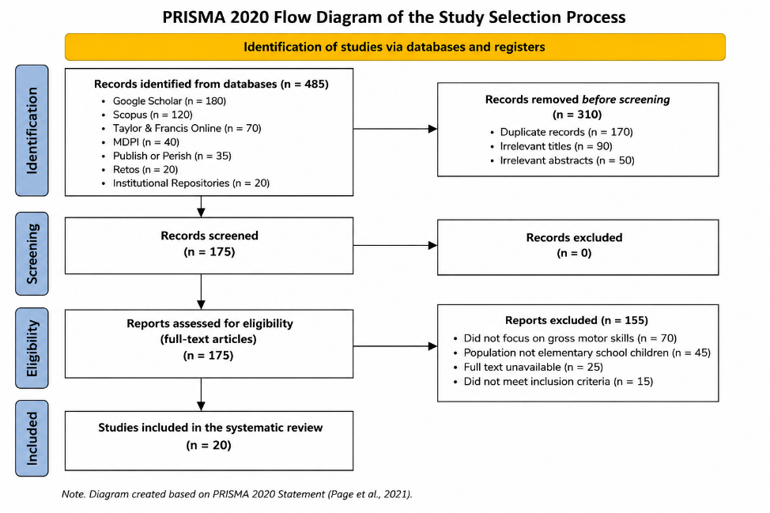
Methods
UNIVERSITAS PENDIDIKAN INDONESIA
PEHR
Physical Education, Health, and Recreation
STUDY PROGRAM
Faculty of Sport Education and Health
This study employs the Systematic Literature Review (SLR) method, adhering to the PRISMA 2020 (Preferred Reporting Items for Systematic Reviews and Meta-Analyses) guidelines. According to Page et al. (2021), PRISMA provides guidelines aimed at enhancing the transparency, quality, and completeness of systematic review reports, ensuring that the processes of identifying, selecting, evaluating, and synthesizing articles are conducted systematically and remain replicable by other researchers. A Systematic Literature Review is a research method used to identify, assess, and synthesize relevant research findings in a structured manner to gain a comprehensive understanding of a specific research topic (Snyder, 2019; Page et al., 2021).

Slide 5
UNIVERSITAS PENDIDIKAN INDONESIA
Result & Discussion
PEHR
Physical Education, Health, and Recreation
STUDY PROGRAM
Faculty of Sport Education and Health
The synthesis of 20 studies indicates that gross motor skill development among elementary school students varies according to age, gender, physical activity, school environment, and opportunities for movement. Most studies report that students are generally at the elementary (transitional) stage, meaning they have mastered basic movement skills but have not yet reached full movement maturity (Bolger et al., 2022; Valentini et al., 2022). This finding is consistent with motor development theory, which states that elementary school is a critical period for refining fundamental movement skills through continuous practice and experience (Haywood & Getchell, 2022). Furthermore, children who participate more frequently in physical activity and physical education demonstrate higher levels of motor competence than their less active peers (Luz et al., 2022; Belanger et al., 2023).
The review also shows that locomotor skills (walking, running, jumping, and hopping) are the most developed motor components because they are practiced regularly in children's daily lives (Duncan et al., 2022; Nobre et al., 2022). Frequent movement experiences positively influence locomotor competence and increase children's confidence to participate in sports and physical activities (Lopes et al., 2022; King-Dowling et al., 2022).

Slide 6
UNIVERSITAS PENDIDIKAN INDONESIA
PEHR
Result & Discussion
Physical Education, Health, and Recreation
STUDY PROGRAM
Faculty of Sport Education and Health
Compared with locomotor skills, manipulative skills such as throwing, catching, and kicking remain less developed because they require more complex visual-motor coordination and structured practice (Bardid et al., 2022; Brian et al., 2022). Boys generally achieve higher manipulative scores than girls, although equal learning opportunities can reduce these differences (Bardid et al., 2022; Palmer et al., 2022). Stability skills, including balance and postural control, are generally at a moderate level and can be improved through balance and coordination training (Palmer et al., 2022; Rudd et al., 2022).
The review further identifies several factors affecting gross motor development, including age, physical activity, school and family environments, nutritional status, and access to sports facilities (Valentini et al., 2022; Webster et al., 2023). Conversely, excessive screen time and sedentary behavior may hinder motor development (Liu et al., 2023). Therefore, Physical Education (PJOK) should provide balanced instruction in locomotor, manipulative, and stability skills through play-based and game-based learning approaches, supported by adequate school facilities and active family involvement to optimize children's gross motor development (Hulteen et al., 2023; Rudd et al., 2022).

Slide 7
Conclusion
UNIVERSITAS PENDIDIKAN INDONESIA
PEHR
Physical Education, Health, and Recreation
STUDY PROGRAM
Faculty of Sport Education and Health
This systematic literature review demonstrates that the gross motor skill development of public elementary school students generally falls within the elementary (transitional) stage, indicating that although most students have acquired fundamental movement skills, they have not yet reached full motor maturity. Locomotor skills are consistently more developed than manipulative and stability skills, while gross motor competence is influenced by factors such as age, gender, physical activity, nutritional status, family and school environments, the quality of physical education, and the availability of physical activity facilities. These findings highlight the importance of providing structured physical education programs and supportive learning environments to enhance children's motor competence. Therefore, schools, teachers, families, and policymakers should work collaboratively to create opportunities that promote regular physical activity and optimize the gross motor development of elementary school students.

Slide 8
References
UNIVERSITAS PENDIDIKAN INDONESIA
PEHR
Physical Education, Health, and Recreation
STUDY PROGRAM
Faculty of Sport Education and Health
Aubert, S., Barnes, J. D., Demchenko, I., Hawthorne, M., Abdeta, C., Abi Nader, P., ... Tremblay, M. S. (2022). Global Matrix 4.0 Physical Activity Report Card Grades for Children and Adolescents: Results and analyses from 57 countries. Journal of Physical Activity and Health, 19(11), 700–728. https://doi.org/10.1123/jpah.2022-0456
Bardid, F., Huyben, F., Deconinck, F. J. A., De Martelaer, K., Seghers, J., Lenoir, M., & D’Hondt, E. (2022). Fundamental motor skills and physical activity in children: A systematic review. Journal of Science and Medicine in Sport, 25(4), 345–352.
Barnett, L. M., Webster, E. K., Hulteen, R. M., De Meester, A., Valentini, N. C., Lenoir, M., Pesce, C., Getchell, N., Lopes, V. P., Robinson, L. E., Brian, A., & Rodrigues, L. P. (2022). Through the looking glass: A systematic review of longitudinal evidence, providing new insight for motor competence and health. Sports Medicine, 52(4), 875–920.
Belanger, K., Barnes, J. D., Longmuir, P. E., Anderson, K. D., Bruner, B., Copeland, J. L., Gregg, M. J., Hall, N., Kolen, A. M., Law, B., & Tremblay, M. S. (2023). The relationship between physical activity and motor competence in children and youth. International Journal of Behavioral Nutrition and Physical Activity, 20(1), 68.
Bolger, L. E., Bolger, L. A., O'Neill, C., Coughlan, E., O'Brien, W., Lacey, S., Burns, C., & Bardid, F. (2022). Global levels of fundamental movement skills in children: A systematic review. Journal of Sports Sciences, 40(3), 273–290.
Brian, A., Bardid, F., Barnett, L. M., Deconinck, F., Lenoir, M., & Goodway, J. D. (2022). Actual and perceived motor competence among children: A systematic review. Sports Medicine, 52(11), 2621–2641.
Duncan, M. J., Roscoe, C. M. P., Faghy, M. A., Tallis, J., Eyre, E. L. J., & Stodden, D. F. (2022). Development of motor competence and physical fitness in children. Sports, 10(5), 74.
Goodway, J. D., Ozmun, J. C., & Gallahue, D. L. (2021). Understanding motor development: Infants, children, adolescents, adults (9th ed.). Jones & Bartlett Learning.

Slide 9
References
UNIVERSITAS PENDIDIKAN INDONESIA
PEHR
Physical Education, Health, and Recreation
STUDY PROGRAM
Faculty of Sport Education and Health
Haywood, K. M., & Getchell, N. (2022). Life span motor development (8th ed.). Human Kinetics.
He, Y., Zhou, L., Liang, W., Liu, Q., Liu, W., & Wang, S. (2024). Individual, family, and environmental correlates of fundamental motor skills among school-aged children: A cross-sectional study in China. BMC Public Health, 24, 208. https://doi.org/10.1186/s12889-024-17728-2
Hulteen, R. M., Morgan, P. J., Barnett, L. M., Stodden, D. F., & Lubans, D. R. (2022). Development of foundational movement skills: A conceptual model for physical activity across the lifespan. Sports Medicine, 52(10), 2273–2288.
King-Dowling, S., Proudfoot, N. A., Cairney, J., & Timmons, B. W. (2022). Motor competence and physical activity in school-aged children. Medicine & Science in Sports & Exercise, 54(8), 1328–1336.
Logan, S. W., Robinson, L. E., Wilson, A. E., & Lucas, W. A. (2022). Getting the fundamentals of movement: A meta-analysis of the effectiveness of motor skill interventions in children. Child: Care, Health and Development, 48(2), 185–199.
Lorenzo-Martínez, M., Abelairas-Gómez, C., Carballo-Fazanes, A., & Rey, E. (2025). Prevalence of fundamental movement skill mastery in school-aged children and adolescents: A systematic review. BMJ Open Sport & Exercise Medicine, 11(4), e002439.
Lopes, V. P., Rodrigues, L. P., Maia, J. A. R., & Malina, R. M. (2022). Motor coordination and physical activity in children and adolescents. Research Quarterly for Exercise and Sport, 93(1), 1–11.
Liu, Y., Li, Z., Yuan, L., & Zhou, Z. (2023). The bidirectional correlation between fundamental motor skill and moderate-to-vigorous physical activities: A systematic review and meta-analysis. Children, 10(9), 1504. https://doi.org/10.3390/children10091504
Luz, C., Rodrigues, L. P., Cordovil, R., & Lima, R. (2022). Motor competence and physical activity in children: A longitudinal approach. International Journal of Environmental Research and Public Health, 19(14), 8675.
Moon, J., Webster, C. A., Stodden, D. F., Brian, A., Mulvey, K. L., Beets, M., Egan, C. A., McIntosh, L. I. F., Merica, C. B., & Russ, L. (2024). Systematic review and meta-analysis of physical activity interventions to increase elementary children's motor competence: A comprehensive school physical activity program perspective. BMC Public Health, 24, 826. https://doi.org/10.1186/s12889-024-18145-1

Slide 10
References
UNIVERSITAS PENDIDIKAN INDONESIA
PEHR
Physical Education, Health, and Recreation
STUDY PROGRAM
Faculty of Sport Education and Health
Nobre, F. S. S., Bandeira, P. F. R., Valentini, N. C., & Tani, G. (2022). Development of locomotor skills in childhood: A systematic review. Human Movement Science, 82, 102917.
Page, M. J., McKenzie, J. E., Bossuyt, P. M., Boutron, I., Hoffmann, T. C., Mulrow, C. D., Shamseer, L., Tetzlaff, J. M., Akl, E. A., Brennan, S. E., Chou, R., Glanville, J., Grimshaw, J. M., Hróbjartsson, A., Lalu, M. M., Li, T., Loder, E. W., Mayo-Wilson, E., McDonald, S., ... Moher, D. (2021). The PRISMA 2020 statement: An updated guideline for reporting systematic reviews. BMJ, 372, n71.
Pereira, S., Bastos, F., Santos, C., Maia, J., Tani, G., Robinson, L. E., & Katzmarzyk, P. T. (2022). Variation and predictors of gross motor coordination development in Azorean children: A quantile regression approach. International Journal of Environmental Research and Public Health, 19(9), 5417. https://doi.org/10.3390/ijerph19095417
Snyder, H. (2019). Literature review as a research methodology: An overview and guidelines. Journal of Business Research, 104, 333–339. https://doi.org/10.1016/j.jbusres.2019.07.039
Robinson, L. E., Stodden, D. F., Barnett, L. M., Lopes, V. P., Logan, S. W., Rodrigues, L. P., & D’Hondt, E. (2022). Motor competence and its effect on positive developmental trajectories of health. Sports Medicine, 52(8), 1703–1716.
Rudd, J. R., Crotti, M., Fitton-Davies, K., O'Callaghan, L., Bardid, F., Utesch, T., Roberts, S., & Cronin, J. (2022). Skill acquisition methods fostering movement competence in children. Sports Medicine, 52(6), 1247–1272.
Valentini, N. C., Clark, J. E., Whitall, J., & Goodway, J. D. (2022). Developmental trajectories of fundamental movement skills in children. Research Quarterly for Exercise and Sport, 93(3), 467–479.
Webster, E. K., Brian, A., Stodden, D. F., & Goodway, J. D. (2023). Physical education and motor competence development in elementary school children. Journal of Teaching in Physical Education, 42(3), 287–299.
Yin, X., Zhang, D., Shen, Y., Li, Y., Wang, Z., & Chen, X. (2025). Effectiveness of school-based interventions on fundamental movement skills in children: A systematic review and meta-analysis. BMC Public Health, 25, 1522.
Zhang, Y., Li, X., Chen, H., & Wang, J. (2024). The effects of active play interventions on children’s fundamental movement skills: A systematic review. BMC Pediatrics, 24, 421.

