Slide 1








UNIVERSITAS PENDIDIKAN INDONESIA
PEHR
Physical Education, Health, and Recreation
STUDY PROGRAM
Faculty of Sport Education and Health
Efektivitas Pendekatan Teaching at the Right Level (TaRL) terhadap Hasil Belajar Siswa pada Pembelajaran Pendidikan Jasmani
Yusup Mahendra
Affiliation

Slide 2


UNIVERSITAS PENDIDIKAN INDONESIA
The Merdeka Curriculum places students at the center of the learning process by promoting differentiated instruction that considers learners' individual needs, characteristics, and learning abilities. In its implementation, teachers are expected to design learning activities that not only focus on achieving learning competencies but also accommodate students' diverse abilities, ensuring that every learner has an equal opportunity to achieve optimal learning outcomes.
In Physical Education (PE), the diversity of students' abilities presents a significant challenge. Differences in motor skills, sports experience, physical fitness levels, and learning readiness often make traditional one-size-fits-all instructional approaches less effective in meeting students' learning needs. As a result, some students struggle to follow the learning process, while those with higher abilities receive insufficient challenges. This situation may reduce students' participation and ultimately affect their learning outcomes.
PEHR
Physical Education, Health, and Recreation
STUDY PROGRAM
Faculty of Sport Education and Health
Introduction

Slide 3
UNIVERSITAS PENDIDIKAN INDONESIA
PEHR
Physical Education, Health, and Recreation
STUDY PROGRAM
Faculty of Sport Education and Health
To address these challenges, one promising approach is Teaching at the Right Level (TaRL). TaRL emphasizes students' actual learning abilities as the basis for instructional planning through diagnostic assessment, ability-based grouping, and learning activities tailored to students' needs. By adapting instruction to students' competency levels, TaRL creates a more adaptive, effective, and student-centered learning environment.
Although numerous studies have reported the positive impact of TaRL on students' learning outcomes across various academic subjects, research specifically examining its effectiveness in Physical Education remains limited. Furthermore, existing findings are scattered across different publications, making it difficult to obtain a comprehensive understanding of TaRL implementation in PE. Therefore, this study aims to synthesize existing research through a Systematic Literature Review (SLR) to provide stronger scientific evidence regarding the effectiveness of the Teaching at the Right Level (TaRL) approach in improving learning outcomes in Physical Education.
Introduction

Slide 4
UNIVERSITAS PENDIDIKAN INDONESIA
PEHR
Physical Education, Health, and Recreation
STUDY PROGRAM
Faculty of Sport Education and Health
Although the Teaching at the Right Level (TaRL) approach has been widely studied and has demonstrated its effectiveness in improving students' learning outcomes across various subjects, most existing studies have focused on academic disciplines such as Mathematics, Science (IPAS), Indonesian Language, and English. In contrast, research specifically investigating the implementation of TaRL in Physical Education (PE) remains relatively limited. Furthermore, the existing evidence is scattered across different publications, making it difficult to obtain a comprehensive understanding of TaRL's effectiveness in the context of Physical Education. Therefore, a Systematic Literature Review (SLR) is needed to systematically identify, evaluate, and synthesize the available evidence, providing a more comprehensive understanding of the effectiveness of the TaRL approach in improving learning outcomes in Physical Education.
Research Gap

Slide 5
UNIVERSITAS PENDIDIKAN INDONESIA
PEHR
Physical Education, Health, and Recreation
STUDY PROGRAM
Faculty of Sport Education and Health
The novelty of this study lies in its effort to systematically synthesize existing research on the effectiveness of the Teaching at the Right Level (TaRL) approach in Physical Education (PE) using the Systematic Literature Review (SLR) method guided by the PRISMA 2020 framework. Unlike previous studies, which have primarily examined the implementation of TaRL in a single school setting or within a specific subject, this study provides a more comprehensive synthesis of the characteristics of existing research, the implementation strategies of TaRL, and its impact on students' learning outcomes in Physical Education. Consequently, this review offers broader evidence that can serve as a reference for researchers, educators, and policymakers in implementing differentiated learning through the TaRL approach..
Novelty

Slide 6
UNIVERSITAS PENDIDIKAN INDONESIA
PEHR
Physical Education, Health, and Recreation
STUDY PROGRAM
Faculty of Sport Education and Health
To analyze the effectiveness of the Teaching at the Right Level (TaRL) approach on students' learning outcomes in Physical Education (PE) through a Systematic Literature Review (SLR).
Specific Objectives
To identify the characteristics of studies on TaRL implementation.
To examine the implementation of TaRL in Physical Education.
To evaluate the impact of TaRL on students' learning outcomes.
To synthesize research findings and provide evidence-based recommendations for adaptive and differentiated Physical Education instruction.
Research Objectives

Slide 7
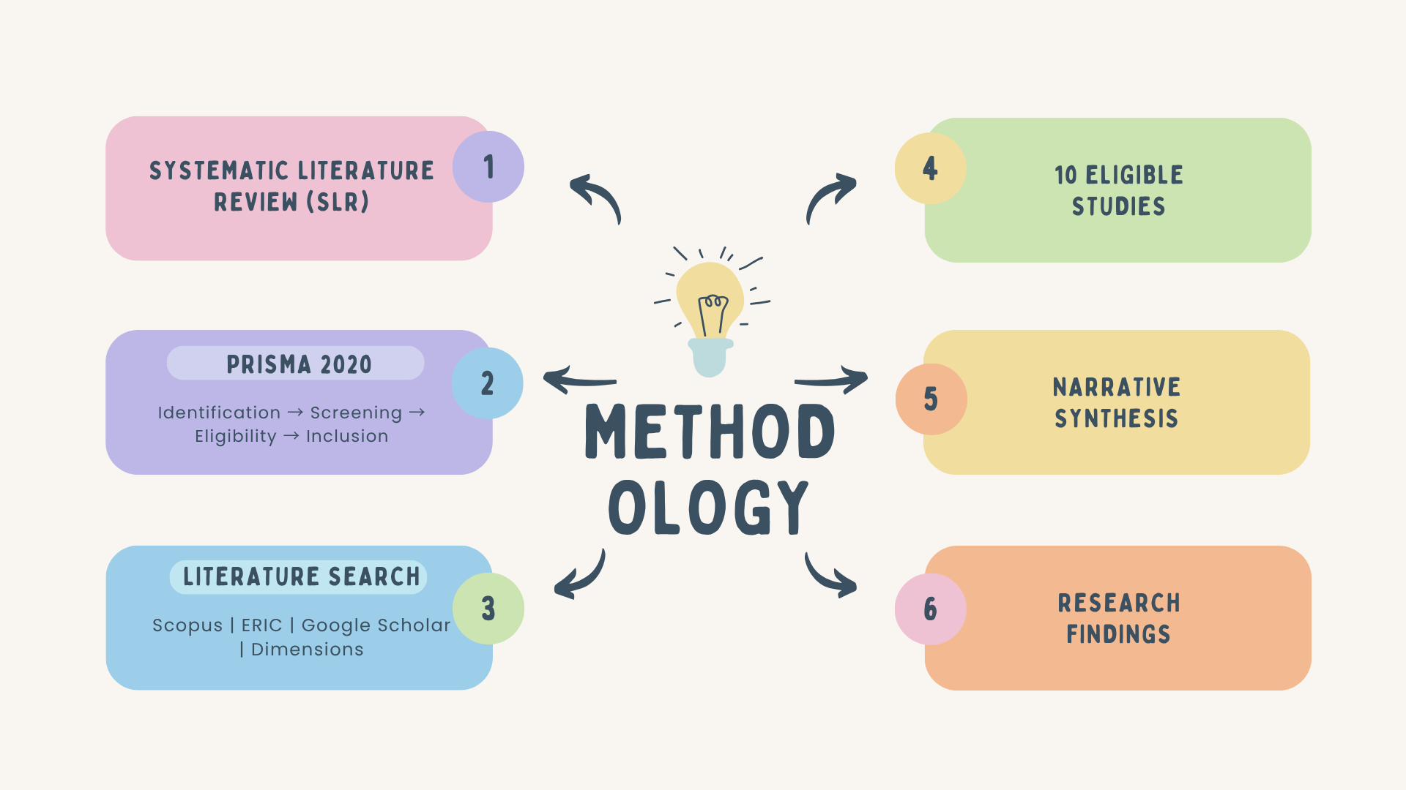
UNIVERSITAS PENDIDIKAN INDONESIA
PEHR
Physical Education, Health, and Recreation
STUDY PROGRAM
Faculty of Sport Education and Health
Methodology

Slide 8
UNIVERSITAS PENDIDIKAN INDONESIA
PEHR
Physical Education, Health, and Recreation
STUDY PROGRAM
Faculty of Sport Education and Health
Following the PRISMA 2020 framework, 60 articles were initially identified from four academic databases. After duplicate removal, title and abstract screening, and full-text eligibility assessment, 10 studies met the inclusion criteria and were included in the review. The increasing number of studies published in recent years reflects the growing interest in implementing the Teaching at the Right Level (TaRL) approach, particularly following the adoption of the Merdeka Curriculum in Indonesia.
Specific Objectives
The selected studies were conducted across various educational levels, ranging from elementary to senior high schools, and employed diverse research designs, including experimental, quasi-experimental, mixed-method, and Classroom Action Research (CAR). Overall, the findings consistently demonstrate that the implementation of TaRL contributes positively to improving students' learning outcomes in different educational settings.
Results

Slide 9
UNIVERSITAS PENDIDIKAN INDONESIA
PEHR
Physical Education, Health, and Recreation
STUDY PROGRAM
Faculty of Sport Education and Health
The synthesis of the selected studies revealed a consistent pattern in the implementation of the Teaching at the Right Level (TaRL) approach in Physical Education (PE). The implementation generally began with a diagnostic assessment to identify students' initial learning abilities, followed by ability-based grouping, and the adaptation of learning activities according to the needs of each group. This instructional sequence enabled teachers to provide learning experiences that were better aligned with students' actual competency levels, resulting in a more meaningful, student-centered, and effective learning process.
Discussion

Slide 10
UNIVERSITAS PENDIDIKAN INDONESIA
PEHR
Physical Education, Health, and Recreation
STUDY PROGRAM
Furthermore, all studies included in this review consistently reported that the implementation of the TaRL approach had a positive impact on students' learning outcomes. In the context of Physical Education, TaRL contributed to improvements in motor skills, mastery of fundamental sports techniques, learning motivation, and active student engagement throughout the learning process. These findings suggest that instruction tailored to students' learning levels is more effective than traditional one-size-fits-all teaching approaches in promoting meaningful learning and improving educational outcomes.
Despite these positive findings, several challenges remain in implementing the TaRL approach effectively. The most frequently reported challenges include teachers' readiness to conduct diagnostic assessments, their ability to manage heterogeneous learning groups, and the availability of appropriate learning resources and instructional media. Therefore, the successful implementation of TaRL depends not only on the instructional approach itself but also on teachers' pedagogical competence in designing flexible, adaptive, and differentiated learning experiences that address the diverse needs of students.
Faculty of Sport Education and Health
Discussion

Slide 11
UNIVERSITAS PENDIDIKAN INDONESIA
PEHR
Physical Education, Health, and Recreation
STUDY PROGRAM
Furthermore, all studies included in this review consistently reported that the implementation of the TaRL approach had a positive impact on students' learning outcomes. In the context of Physical Education, TaRL contributed to improvements in motor skills, mastery of fundamental sports techniques, learning motivation, and active student engagement throughout the learning process. These findings suggest that instruction tailored to students' learning levels is more effective than traditional one-size-fits-all teaching approaches in promoting meaningful learning and improving educational outcomes.
Despite these positive findings, several challenges remain in implementing the TaRL approach effectively. The most frequently reported challenges include teachers' readiness to conduct diagnostic assessments, their ability to manage heterogeneous learning groups, and the availability of appropriate learning resources and instructional media. Therefore, the successful implementation of TaRL depends not only on the instructional approach itself but also on teachers' pedagogical competence in designing flexible, adaptive, and differentiated learning experiences that address the diverse needs of students.
Faculty of Sport Education and Health
Discussion

Slide 12
UNIVERSITAS PENDIDIKAN INDONESIA
PEHR
Conclution
Physical Education, Health, and Recreation
STUDY PROGRAM
Faculty of Sport Education and Health
Based on the findings of this Systematic Literature Review (SLR), which synthesized evidence from 10 eligible studies, it can be concluded that the Teaching at the Right Level (TaRL) approach is an effective instructional strategy for improving students' learning outcomes, including in Physical Education (PE). The reviewed studies consistently demonstrated that the implementation of TaRL contributes to improvements in motor skills, conceptual understanding, learning motivation, and students' active engagement throughout the learning process.
The successful implementation of TaRL is supported by three essential components: diagnostic assessment, ability-based grouping, and the provision of learning activities tailored to students' individual learning needs. These components enable teachers to deliver differentiated instruction that better accommodates learners' diverse abilities and promotes more meaningful learning experiences.
Therefore, the Teaching at the Right Level (TaRL) approach can be considered a promising strategy for supporting differentiated instruction within the Merdeka Curriculum. Its implementation has the potential to enhance the quality of Physical Education by fostering a learning environment that is more adaptive, inclusive, student-centered, and responsive to learners' varying levels of readiness and ability.

Slide 13
UNIVERSITAS PENDIDIKAN INDONESIA
PEHR
Physical Education, Health, and Recreation
STUDY PROGRAM
Faculty of Sport Education and Health
Reference
Banerjee, A., Banerji, R., Duflo, E., Glennerster, R., & Khemani, S. (2021). Mainstreaming an Effective Intervention: Evidence from Randomized Evaluations of Teaching at the Right Level. National Bureau of Economic Research.
Bailey, R. (2006). Physical Education and Sport in Schools: A Review of Benefits and Outcomes. Journal of School Health, 76(8), 397–401. https://doi.org/10.1111/j.1746-1561.2006.00132.x
Kementerian Pendidikan, Kebudayaan, Riset, dan Teknologi. (2022). Panduan Pembelajaran dan Asesmen pada Kurikulum Merdeka. Jakarta: Kemendikbudristek.
Page, M. J., McKenzie, J. E., Bossuyt, P. M., Boutron, I., Hoffmann, T. C., Mulrow, C. D., et al. (2021). The PRISMA 2020 Statement: An Updated Guideline for Reporting Systematic Reviews. BMJ, 372, n71.
Pangestu, A. Y., & Pratama, D. S. (2025). The Influence of Teaching at the Right Level (TaRL) Learning Strategy on Physical Education Learning Outcomes: A Mixed Method Study in Vocational High Schools. Sang Pencerah: Jurnal Ilmiah Universitas Muhammadiyah Buton, 11(1), 122–131.
SHAPE America. (2014). National Standards & Grade-Level Outcomes for K–12 Physical Education. Champaign, IL: Human Kinetics.
Tomlinson, C. A. (2017). How to Differentiate Instruction in Academically Diverse Classrooms (3rd ed.). Alexandria, VA: ASCD.

Slide 14
UNIVERSITAS PENDIDIKAN INDONESIA
PEHR
Physical Education, Health, and Recreation
STUDY PROGRAM
Faculty of Sport Education and Health
Thank You
Your Name
Affiliation

