Slide 1


PEHR
UNIVERSITAS PENDIDIKAN INDONESIA
Physical Education, Health, and Recreation
STUDY PROGRAM
Faculty of Sport Education and Health
The Importance of Life Skills Integration in Youth Football Training Programs
Muhamad Tafaqur
Universitas Pendidikan Indonesia

Slide 2
PEHR
UNIVERSITAS PENDIDIKAN INDONESIA
Introduction
Adolescence is a period of rapid growth and development, both physically, psychologically, and intellectually. Adolescents are typically curious, enjoy adventure and challenges, and tend to take risks without careful consideration. If they make inappropriate decisions in the face of conflict, they will engage in risky behavior and may suffer short-term and long-term consequences, including various physical and psychosocial health problems (Ministry of Health, 2015).
For adolescents to lead successful and healthy lives, they need a variety of life skills development (Gould, 2008). Life skills are important to be developed in children and adolescents because they will prepare themselves for social life that changes from year to year so that they can survive (Paparicharisis, et all., 2025). Life skills development is very important especially for children and adolescents who will later use life skills to interact with their environment (Pierce, 2017)
Life skills are deﬁned as “those skills that enable individuals to succeed in the diﬀerent environments in which they live, such as school, home, and in their neighborhoods (Danish, et. all : 2014). "Life skills" are defined as psychosocial abilities for adaptive and positive behaviour that enable individuals to deal effectively with the demands and challenges of everyday life (Unicef , 2023)
Physical Education, Health, and Recreation
STUDY PROGRAM
Faculty of Sport Education and Health

Slide 3
PEHR
UNIVERSITAS PENDIDIKAN INDONESIA
Physical Education, Health, and Recreation
STUDY PROGRAM
Faculty of Sport Education and Health
Introduction
Cruz et al. (1996) in (Cecchini et al., 2007) commented that organizers of competitive sporting events, coaches, and parents place excessive emphasis on the outcome of sporting activities with a frequent emphasis on winning at all costs, which causes what was originally a fun game to become something very similar to work and can contribute to making youth behave aggressively.
Cope et al. (2017) stated that given the role of football as a global game involving participation across all levels of society from youth to adults, it is clear that more empirical work is needed to consider how life skills can be developed through this sport, and transferred to other life domains
The results of research by Papacharisis et al. (2005) show that when life skills training is applied appropriately in sports practice, the life skills learned do not sacrifice the learning of sports skills, instead young athletes can improve their performance.
Considering how important life skills are for young people to be able to interact with their surroundings and achieve success in their lives, soccer coaches must integrate life skills into their training programs, especially in training programs for young ages.

Slide 4
PEHR
UNIVERSITAS PENDIDIKAN INDONESIA
Physical Education, Health, and Recreation
STUDY PROGRAM
Faculty of Sport Education and Health
Methods
The method used in this research is literature review method. Literature search was carried out from January to December 2020, article searches were importance of integrating life skills in football training program. The publication period for the articles cited is 1992 to 2025.

Slide 5
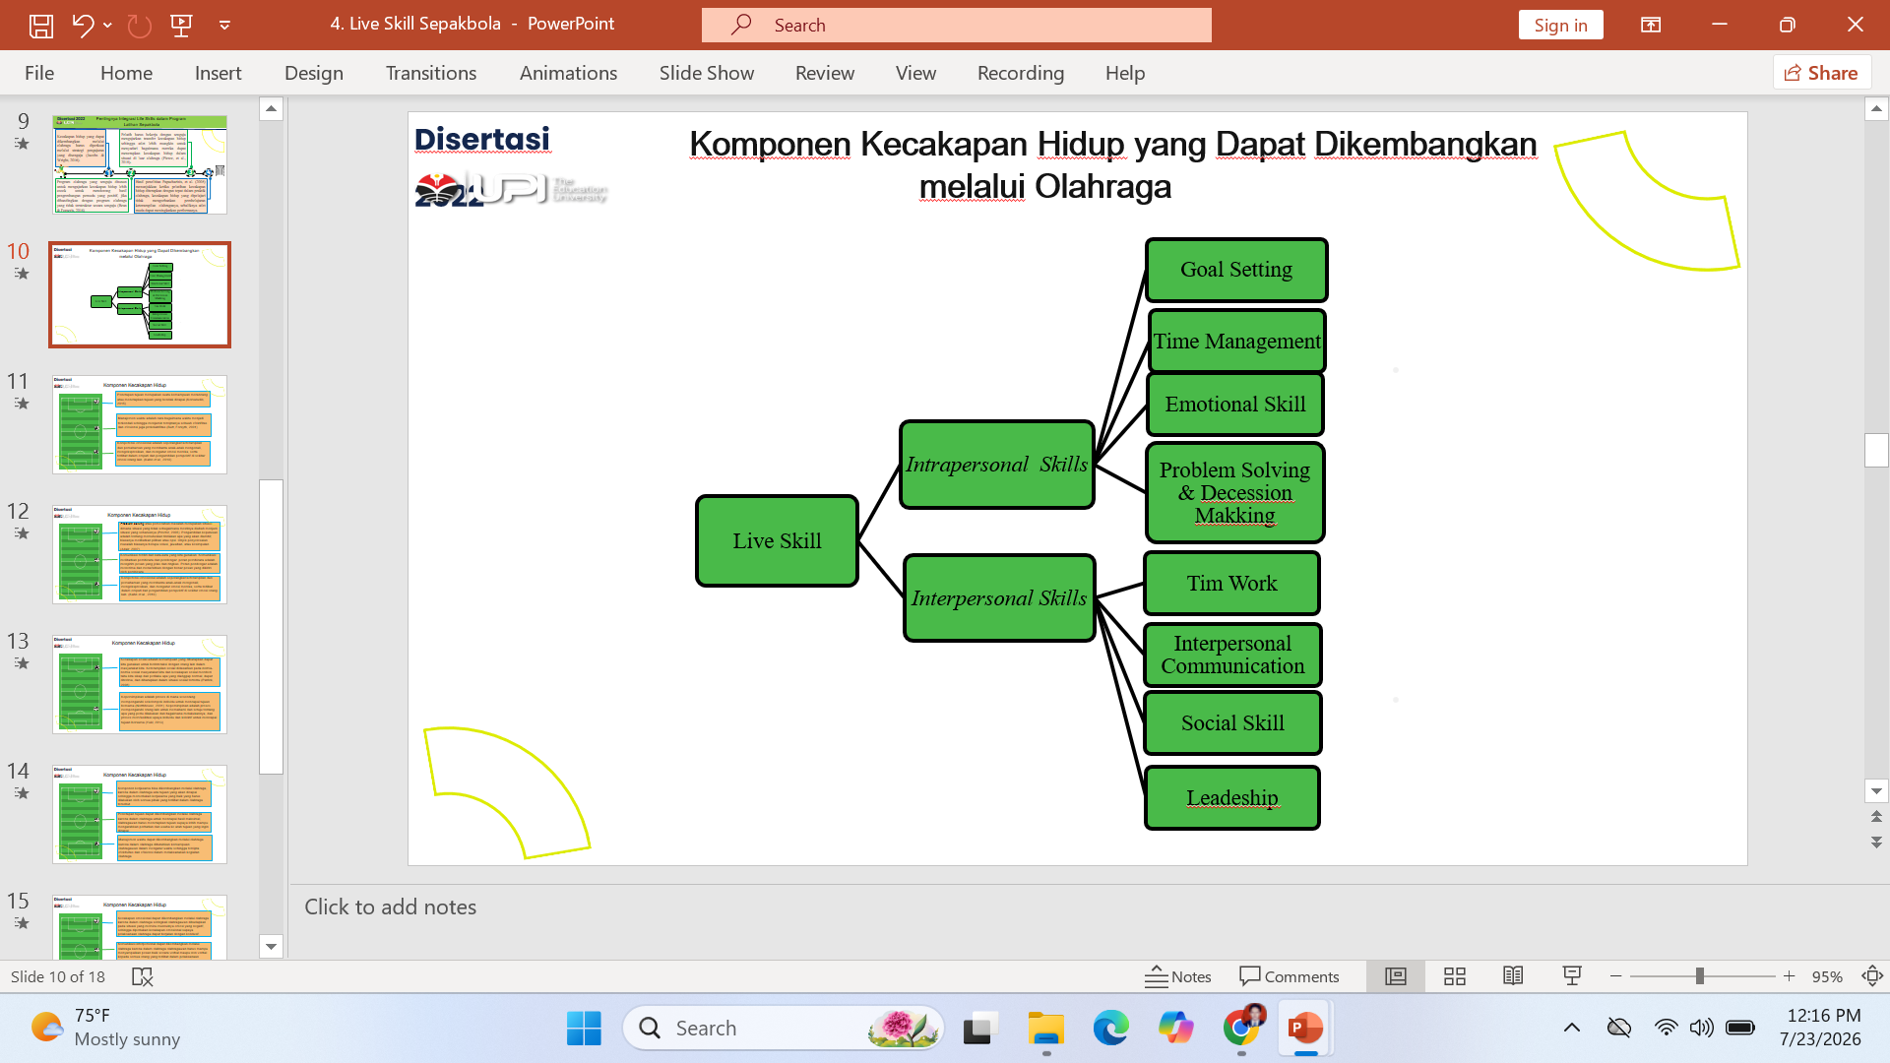
PEHR
UNIVERSITAS PENDIDIKAN INDONESIA
Result and Discussion
Components of life skills include teamwork, goal setting, time management, emotional skills, interpersonal communication, social skills, leadership, problem solving and decision making (Cronin, et all., 2017).
Gambar 1. Live Skill Components
Physical Education, Health, and Recreation
STUDY PROGRAM
Faculty of Sport Education and Health

Slide 6
PEHR
UNIVERSITAS PENDIDIKAN INDONESIA
Result and Discussion
Goal setting is the ability to design or determine goals to be achieved (Komarudin, 2015).
Time management is a way of controlling time to ensure effectiveness, efficiency and productivity (Burt, Forsyth, 2001).
Emotional competence is a set of skills and understandings that help children recognize, express, and regulate their emotions, as well as engage in empathy and perspective-taking around the emotions of others (Kahn et al., 2019).
Decision marking is about deciding what action to take; it usually involves choice between option. The object of problem solving is usually a solution, answer or conclusion (Adair, 2007). Whereas problem solfing or problem solving is a situation where the situation that is not as it should be changed to the situation that should be (Proctor, 2005).
Physical Education, Health, and Recreation
STUDY PROGRAM
Faculty of Sport Education and Health

Slide 7
PEHR
UNIVERSITAS PENDIDIKAN INDONESIA
Result and Discussion
ITeam work is a dynamic process that involves collaborative efforts by team members to effectively carry out the independent and interdependent behaviors needed to maximize the team's chances of achieving its goals. Cooperation done by team members will be more effective than work done individually (Mc. Ewan, et all., 2017).
Interpersonal communication for teenagers is needed. According to Partners for Local Development "we cannot be human alone, we life a world filled with other people, we live together, work together, and play together, we need each other for security, comfort, friendship, and love, we need each other to mature through dialogue, and we need each other to achieve our goals and objectives (Partners for Local Development Fondation)
Social skills are the abilities we are expected to use to interact with others in our society. Social skills are based on the social norms of our society, and they tell us what attitudes and behaviors are considered normal, acceptable, and expected in certain social situations (Patrick, 2008).
Leadership is a process in which a person influences a group of individuals to achieve a common goal (Northhouse, 2001).
Physical Education, Health, and Recreation
STUDY PROGRAM
Faculty of Sport Education and Health

Slide 8
PEHR
UNIVERSITAS PENDIDIKAN INDONESIA
Result and Discussion
The process of facilitating the transfer of life skills can be done in two ways: an implicit approach and an explicit approach. In the implicit approach, coaches do not use deliberate strategies to teach the transfer of life skills, but athletes can implicitly develop assets and skills based on their sporting experiences and then transfer these life skills if they find them useful in other areas of life (Turnnidge et al., 2014).
An explicit approach refers to coaches who intentionally teach life skills, while emphasizing the transferability of these skills to other life domains. In recent years, there has been growing debate and discussion among sport psychology researchers about which approach to life skill transfer is optimal (Turnnidge et al., 2014).
Indeed, previous research has revealed that life skills learning can be done implicitly in sports programs that focus on sports specific skills. However, recent research has shown that sports programs that are deliberately structured to teach life skills may be more suitable for fostering positive teen development outcomes when compared to unintentional exercise programs (Bean, et.all., 216).
Physical Education, Health, and Recreation
STUDY PROGRAM
Faculty of Sport Education and Health

Slide 9
PEHR
UNIVERSITAS PENDIDIKAN INDONESIA
Result and Discussion
Sports programs that are intentionally structured to teach life skills are better suited to promoting positive youth development outcomes, when compared to sports programs that are not intentionally structured (Bean & Forneris, 2016).
Coaches should work intentionally to teach life skills transfer so that athletes are more likely to realize how they can apply life skills in situations outside of sport (Pierce, et al., 2018).
Cope et al. (2017) stated that given the role of football as a global game involving participation across all levels of society from youth to adults, it is clear that more empirical work is needed to consider how life skills can be developed through this sport, and transferred to other life domains (Cope et al., 2017).
Considering how important life skills are for young people to be able to interact with their surroundings and achieve success in their lives, soccer coaches must integrate life skills into their training programs, especially in training programs for young ages
Physical Education, Health, and Recreation
STUDY PROGRAM
Faculty of Sport Education and Health

Slide 10
PEHR
UNIVERSITAS PENDIDIKAN INDONESIA
Conclusion
Life skills need to be developed from a young age to effectively interact with the environment and succeed in life. Football is an excellent tool for developing life skills for young people. Given the importance of life skills for young people, football coaches must be able to integrate life skills into their training programs, particularly those for youth.
Physical Education, Health, and Recreation
STUDY PROGRAM
Faculty of Sport Education and Health

Slide 11
PEHR
UNIVERSITAS PENDIDIKAN INDONESIA
References
Kemenkes ( Situasi Kesehatan Reproduksi Remaja)
Gould D, Carson S. Life skills development through sport: current status and future directions. Int Rev Sport Exerc Psychol. 2008;1(1):58–78.
Papacharisis V, Goudas M, Danish SJ, Theodorakis Y. The effectiveness of teaching a life skills program in a sport context. J Appl Sport Psychol. 2005;17(3):247–54.
Pierce S, Gould D, Camiré M. Definition and model of life skills transfer. Int Rev Sport Exerc Psychol. 2017;10(1):186–211.
Danish SJ, Forneris T, Wallace I. Journal of Applied School Sport-Based Life Skills Programming in the Schools. J Appl Sch Psychol. 2005;(November 2014):37–41
UNICEF. Definition of Terms: Life Skills. 2003; Available from: http://www.unicef.org/ lifeskills/index_7308.htm
Cronin LD, Allen J. Development and initial validation of the Life Skills Scale for Sport. Psychol Sport Exerc [Internet]. 2017;28:105–19. Available from:
Cope, E., Bailey, R., Parnell, D., & Nicholls, A. (2017). Football, sport and the development of young people’s life skills. Sport in Society, 20(7), 789–801. https://doi.org/10.1080/17430437.2016.1207771
Cronin, L. D., & Allen, J. (2017). Development and initial validation of the Life Skills Scale for Sport. Psychology of Sport and Exercise, 28, 105–119. https://doi.org/10.1016/j.psychsport.2016.11.001
McEwan, D., & Beauchamp, M. R. (2014). Teamwork in sport: a theoretical and integrative review. International Review of Sport and Exercise Psychology, 7(1), 229–250. https://doi.org/10.1080/1750984X.2014.932423
Komarudin (2115). Psikologi Olahraga. Rosda.
Physical Education, Health, and Recreation
STUDY PROGRAM
Faculty of Sport Education and Health

Slide 12
PEHR
UNIVERSITAS PENDIDIKAN INDONESIA
References
Partners for Local Development Fondation (n.d). (n.d.). What is Interpersonal Communication.
Patrick, N. J. (2008). Sosial Skills for Teenagers and adults with asperger. London: Jessica Kingsley Publishers
Northhouse, P. G. (2001). Leadership: Theory and practice (2nd ed.). (2nd ed). Thousand Oaks: Sage Publications
Proctor, T. (2005). Creative Solving for Managers.
Bean, C., & Forneris, T. (2016). Examining the Importance of Intentionally Structuring the Youth Sport Context to Facilitate Positive Youth Development. Journal of Applied Sport Psychology, 28(4), 410–425. https://doi.org/10.1080/10413200.2016.1164764
Adair J. Decesion Making and Problem Solving Strategies (2nd Ed.). 2007;
Turnnidge, J., Côté, J., & Hancock, D. J. (2014). Positive Youth Development From Sport to Life: Explicit or Implicit Transfer? Quest, 66(2), 203–217. https://doi.org/10.1080/00336297.2013.867275
Pierce, S., Kendellen, K., Camiré, M., & Gould, D. (2018). Strategies for coaching for life skills transfer. Journal of Sport Psychology in Action, 9(1), 11–20. https://doi.org/10.1080/21520704.2016.1263982
Papacharisis, V., Goudas, M., Danish, S. J., & Theodorakis, Y. (2005). The effectiveness of teaching a life skills program in a sport context. Journal of Applied Sport Psychology, 17(3), 247–254. https://doi.org/10.1080/10413200591010139
Burt, C.D., Forsyth, D. K. (2001). Relationship Between Supervisor Behavior Family Support and Perceived Time Management Ability. New Zealand Jurnal of Psychology, 30, no. 1, 4–8.
Kahn, J., Bailey, R., & Jones, S. (2019). Coaching Social & Emotional Skills in Youth Sports. Aspen Institute, 24. Retrieved from https://files.eric.ed.gov/fulltext/ED603548.pdf
Kemenkes. (2015). Situasi Kesehatan Reproduksi Remaja.
Physical Education, Health, and Recreation
STUDY PROGRAM
Faculty of Sport Education and Health

