Slide 1








UNIVERSITAS PENDIDIKAN INDONESIA
PEHR
Physical Education, Health, and Recreation
STUDY PROGRAM
Faculty of Sport Education and Health
Risk Management in Inclusive Physical Education:
Strategies to Minimize Injuries Among Students with Disabilities
Vina Alviana
Universitas Pendidikan Indonesia

Slide 2

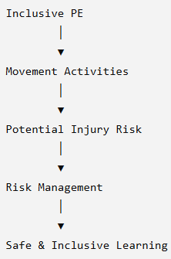

UNIVERSITAS PENDIDIKAN INDONESIA
PEHR
Physical Education, Health, and Recreation
STUDY PROGRAM
Faculty of Sport Education and Health
Why is Risk Management Important in Inclusive Physical Education?
Inclusive Physical Education (IPE) ensures equal participation and meaningful learning opportunities for students with disabilities.
Physical Education involves movement-based activities that increase the potential for injuries.
Students with disabilities are more vulnerable to injuries due to differences in physical, sensory, intellectual, or behavioral characteristics.
Therefore, systematic risk management is essential to create a safe, adaptive, and inclusive learning environment.

Slide 3
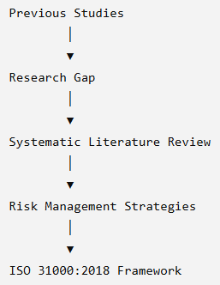
Research Gap & Objective
UNIVERSITAS PENDIDIKAN INDONESIA
PEHR
Physical Education, Health, and Recreation
STUDY PROGRAM
Faculty of Sport Education and Health
Research Gap
Previous studies mainly focused on:
  Adaptive teaching strategies
  Teacher competence
  Student participation
However:
Comprehensive evidence on risk management strategies remains fragmented.
Few studies integrate these strategies within the ISO 31000:2018 Risk Management Framework.
Research Objective
This study aims to:
Identify and synthesize effective risk management strategies in Inclusive Physical Education.
Minimize injury risks among students with disabilities.
Examine how these strategies align with ISO 31000:2018.

Slide 4
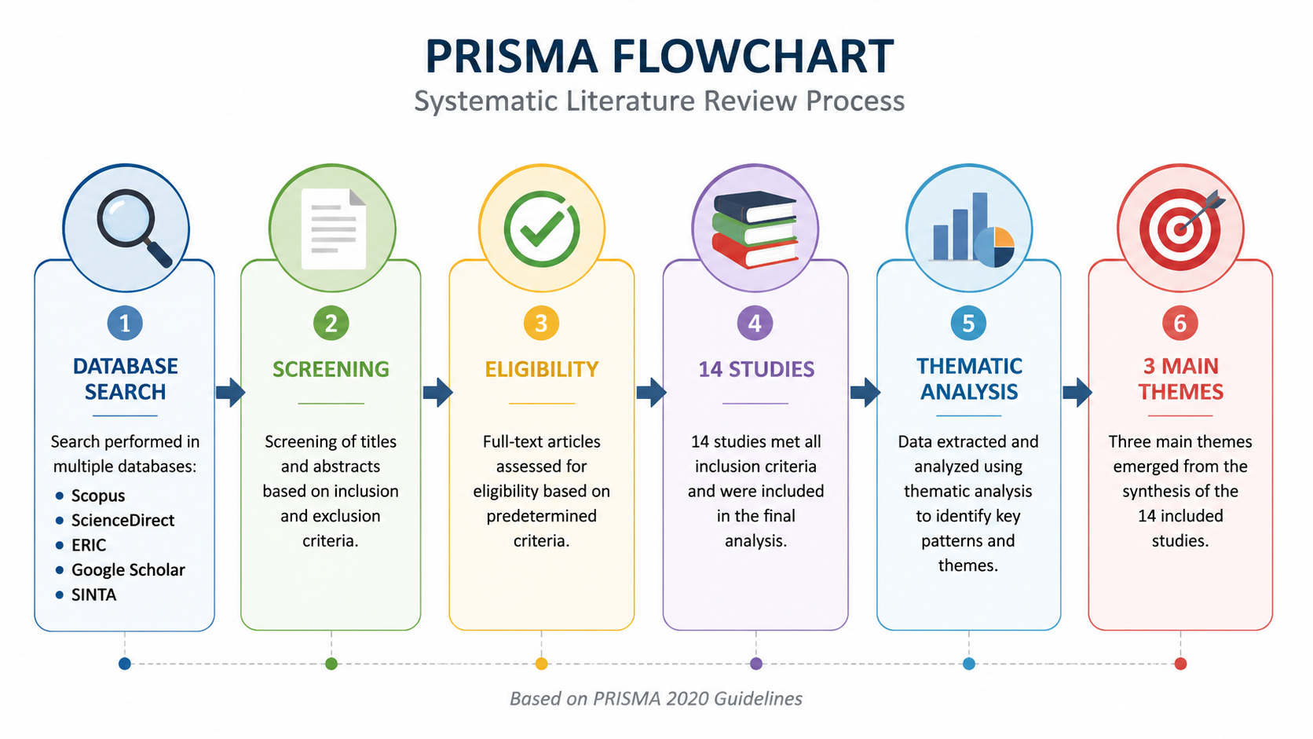
Research Methodology
UNIVERSITAS PENDIDIKAN INDONESIA
PEHR
Physical Education, Health, and Recreation
STUDY PROGRAM
Faculty of Sport Education and Health
Selection Criteria
Peer-reviewed empirical studies
Published between 2018–2024
Focused on:
  Inclusive Physical Education
  Risk Management
  Injury Prevention
  Students with Disabilities
Study Design
Systematic Literature Review (SLR)
Followed the PRISMA 2020 guidelines
Data Analysis
14 eligible studies
Thematic Analysis
Databases
Scopus
ScienceDirect
ERIC
Google Scholar
SINTA
Data Sources
Scopus
ScienceDirect
ERIC
Google Scholar
SINTA

Slide 5
Results of the Systematic Literature Review
UNIVERSITAS PENDIDIKAN INDONESIA
PEHR
Physical Education, Health, and Recreation
STUDY PROGRAM
Faculty of Sport Education and Health
Study Selection
Literature search conducted using PRISMA 2020.
Databases:
  Scopus
  ScienceDirect
  ERIC
  Google Scholar
  SINTA
14 empirical studies met the inclusion criteria.
Aspect | Findings
Publication Year | 2018–2024
Countries | China, Norway, Indonesia, UK, USA, Ukraine
Research Design | Qualitative, Quantitative, Mixed Methods, Case Study, Systematic Review
Main Finding :
Three recurring themes emerged across all included studies.
Adaptation of the Learning Environment
Enhancement of Teacher Competence
Stakeholder Collaboration

Slide 6
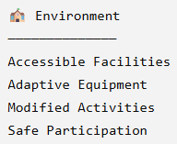
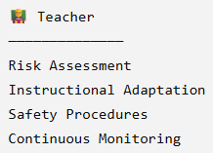
Discussion
UNIVERSITAS PENDIDIKAN INDONESIA
PEHR
Physical Education, Health, and Recreation
STUDY PROGRAM
Faculty of Sport Education and Health
1. Adaptation of the Learning Environment
Accessible facilities
Adaptive sports equipment
Modified learning activities
Flexible instructional strategies
➡ Reduce injury risks while increasing participation
2. Enhancement of Teacher Competence
Teachers should be able to:
Identify potential hazards
Assess students' abilities
Modify instruction
Apply safety procedures
Continuously monitor learning
➡ Teacher competence is the foundation of safe inclusive PE

Slide 7
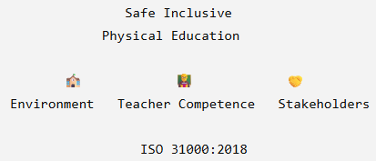
UNIVERSITAS PENDIDIKAN INDONESIA
PEHR
Physical Education, Health, and Recreation
STUDY PROGRAM
Faculty of Sport Education and Health
ISO 31000 | Application
Identify Risk | Student assessment
Assess Risk | Learning activity analysis
Treat Risk | Adapt facilities & instruction
Monitor | Continuous supervision
Communicate | Collaboration among stakeholders
3. Stakeholder Collaboration
Successful inclusive PE requires collaboration among:
Physical Education Teachers
Special Education Teachers
School Principals
Parents
Healthcare Professionals
➡ Shared decision-making improves student safety.
Key Message

Slide 8
Conclusion
UNIVERSITAS PENDIDIKAN INDONESIA
PEHR
Physical Education, Health, and Recreation
STUDY PROGRAM
Faculty of Sport Education and Health
Key Findings
This systematic literature review identified three interconnected risk management strategies in Inclusive Physical Education:
  🏫 Adaptation of the Learning Environment
  👨‍🏫 Enhancement of Teacher Competence
  🤝 Stakeholder Collaboration
These strategies work together to create safe, adaptive, and inclusive learning environments while minimizing injury risks for students with disabilities.
The findings demonstrate that the ISO 31000:2018 framework provides a structured approach for integrating risk management into inclusive physical education through:
  Risk Identification
  Risk Assessment
  Risk Treatment
  Monitoring & Communication
Effective risk management is not about limiting participation
it is about creating safe opportunities for every student to learn, participate, and thrive.

Slide 9
References
UNIVERSITAS PENDIDIKAN INDONESIA
PEHR
Physical Education, Health, and Recreation
STUDY PROGRAM
Faculty of Sport Education and Health
Bertills, K., & Björk, M. (2024). Facilitating regular Physical Education for students with disability—PE teachers’ views. Frontiers in Sports and Active Living.
Blavt, O., & Herasymenko, O. (2024). Inclusive Physical Education of Students with Disabilities Due to War Injuries: Restoration of the Functions of the Lower Extremities. Journal of Learning Theory and Methodology, 5(1), 5–12. https://doi.org/10.17309/jltm.2024.5.1.01
Dharmadi, & P. (2024). Analisis Komparatif Pembelajaran Pendidikan Jasmani, Olahraga dan Kesehatan di Buleleng dan Bima.
Dwi, Y. P. (2024a). Olahraga dan pembelajaran inovatif dalam pendidikan jasmani.
Dwi, Y. P. (2024b). Pedagogi pendidikan jasmani.
Evans, J., & Davies, B. (2024). How Education Policy Actors Interpret, Portray and Contest Risk in Physical Education.
Frontiers in Sports and Active Living. (2024). Facilitating Regular Physical Education for Students with Disability.
Harlow. (2023). Enhancing Inclusive Physical Activity for Students with Disabilities.
International Organization for Standardization (ISO). (2018). ISO 31000:2018 Risk Management—Guidelines. Geneva: ISO.
Lester, S., & Russell, W. (2024). Forces at play: A qualitative study of risk aversion, policy and practice in children’s active play. Children and Youth Services Review.
Love, R., Adams, J., & van Sluijs, E. M. F. (2021). School-based physical activity programs for promoting physical activity and fitness in children and adolescents aged 6 to 18 years: A systematic review. Cochrane Database of Systematic Reviews.
Merlina Sari, Novia Nazirun, & Z. (2023). Pendidikan jasmani adaptif. Repository Universitas Islam Riau.
Nugrohowati, R., & R. (2023). Analisis kualitas hidup anak berkebutuhan khusus melalui pendidikan jasmani adaptif. Jurnal Pendidikan Olahraga Dan Kesehatan, 4(1), 34–42.
Page, M. J., McKenzie, J. E., Bossuyt, P. M. (2021). The PRISMA 2020 statement: An updated guideline for reporting systematic reviews. The BMJ, 372. https://doi.org/10.1136/bmj.n71
Porsanger, L., & Magnussen, L. I. (2024). Risk and Safety Management in Physical Education: A Study of Teachers’ Practice Perspectives.
UNESCO. (2015). Quality Physical Education (QPE): Guidelines for Policy-Makers. United Nations Educational, Scientific and Cultural Organization. https://unesdoc.unesco.org/ark:/48223/pf0000231101
UNESCO. (2024). International Charter of Physical Education, Physical Activity and Sport. United Nations Educational, Scientific and Cultural Organization. https://www.unesco.org/en/legal-affairs/international-charter-physical-education-physical-activity-and-sport
Universitas Teknokrat Indonesia. (2021). Pendidikan jasmani adaptif di sekolah inklusif bagi anak berkebutuhan khusus. Jurnal SPORT, 7(2), 45–55.
Zhou, T., Deng, Y., & Peng, Z. (2022). Research on the Risk of Inclusive Physical Education in Colleges and Universities and Construction of Safety Prevention and Control Mechanism. Analysis Based on Grounded Theory. BCP Education & Psychology, 5, 150–160.

Slide 10
UNIVERSITAS PENDIDIKAN INDONESIA
PEHR
Physical Education, Health, and Recreation
STUDY PROGRAM
Faculty of Sport Education and Health
Thank You...
Are there any questions?
Vina Alviana

