Slide 1








PEHR
UNIVERSITAS PENDIDIKAN INDONESIA
Physical Education, Health, and Recreation
ANALYSIS OF PHYSICAL LITERACY AT MTS DAARUL FIKRIL ULUUM SCHOOL
Takhwin peryoga
2209015

Slide 2


PEHR
UNIVERSITAS PENDIDIKAN INDONESIA
Physical Education, Health, and Recreation
01. 02. 03. 04. 05. 06.
First slide: Title, Autho
Slide 2-3: Introduction
Slide 4: Methods
Slide 5-6:Rsult & Discussion
Slide 7: Conclusion
Slide 8: References
PowerPoint Structure:

Slide 3
PEHR
UNIVERSITAS PENDIDIKAN INDONESIA
Physical Education, Health, and Recreation
Physical literacy merupakan salah satu konsep utama dalam pendidikan jasmani modern yang menekankan pengembangan individu secara menyeluruh. Konsep ini tidak hanya berfokus pada kemampuan melakukan gerakan, tetapi juga mencakup motivasi, kepercayaan diri, kompetensi fisik, pengetahuan, dan pemahaman yang mendorong seseorang untuk aktif bergerak sepanjang hayat
Di lingkungan sekolah, pengembangan physical literacy sangat penting karena dapat membantu siswa membentuk kebiasaan hidup sehat sejak usia dini. Siswa yang memiliki tingkat physical literacy yang baik cenderung lebih percaya diri dalam mengikuti aktivitas pembelajaran pendidikan jasmani, lebih aktif berpartisipasi dalam kegiatan olahraga, serta memiliki kesadaran yang lebih tinggi terhadap pentingnya aktivitas fisik bagi kesehatan.
Oleh karena itu, physical literacy menjadi salah satu indikator penting dalam keberhasilan pembelajaran Pendidikan Jasmani, Olahraga, dan Kesehatan (PJOK).
INTRODUCTION
Presentation Template 6th ISPESH 2026

Slide 4





PEHR
Research Gap
Various studies have shown that physical literacy is positively associated with physical activity, health, well-being, and student engagement in physical education learning. These findings confirm that physical literacy is a crucial factor in developing an active and healthy lifestyle from school age.
However, most research still focuses on the relationships between variables and is conducted outside Indonesia. Research describing the physical literacy levels of Madrasah Tsanawiyah students is still limited, so information on the physical literacy status of students in madrasah environments is scarce.
Based on these conditions, this study aims to analyze the level of physical literacy of students at MTs Daarul Fikril Uluum Binong as an initial description of the condition of students' physical literacy and as a reference in developing physical education learning.

Slide 5
PEHR
RESEARCH METHODS
Research Design
Research Instruments
This study used a quantitative approach with a descriptive design. This approach aims to describe students' physical literacy levels based on data obtained in the field without examining the relationships or influences between variables.
Data were collected using the Physical Literacy Questionnaire, which consists of 21 items on a Likert scale of 1–5. This instrument measures five dimensions of physical literacy: motivation, self-confidence, physical competence, knowledge, and understanding of physical activity.
Research Population
Data Analysis
The study population consisted of 166 students at MTs Daarul Fikril Uluum Binong. The study sample of 118 students was determined using the Slovin formula with the Simple Random Sampling technique, so that each member of the population had an equal opportunity to become a respondent.
The data were analyzed using IBM SPSS Statistics Version 27 through descriptive statistical analysis, which included calculating the mean, median, mode, standard deviation, minimum value, and maximum value to describe the level of students' physical literacy.

Slide 6
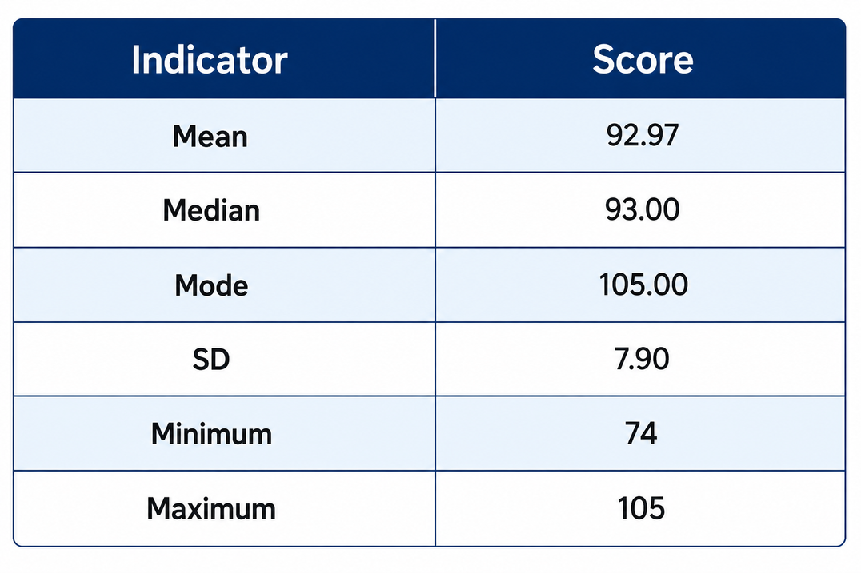


PEHR
RESEARCH RESULT
Statistical analysis shows that the level of physical literacy of students is in the Very Good category. The average physical literacy score is 92.97, with a median of 93.00, a mode of 105.00, a standard deviation of 7.90, a minimum score of 74, and a maximum score of 105. The high average value indicates that most students have good motivation, self-confidence, physical competence, knowledge, and understanding of physical activity.
09

Slide 7
PEHR
The research results show that students at MTs Daarul Fikril Uluum Binong have excellent physical literacy. These findings demonstrate that students possess not only physical abilities but also motivation, self-confidence, knowledge, and a strong understanding of the importance of physical activity.
01.
The results of this study support Whitehead's theory (2010) which states that physical literacy is a combination of physical, affective, and cognitive aspects that encourage a person to be active throughout life.
02
DISCUSSION
The research findings are also consistent with those of Cairney et al. (2019), Cornish et al. (2020), Clark et al. (2022), Britton et al. (2023), and Castillo-Retamal et al. (2024), which show that physical literacy is associated with increased physical activity, health, and student engagement in physical education learning.
03.

Slide 8

PEHR
CONCLUSION
This study shows that the physical literacy level of students at MTs Daarul Fikril Uluum Binong is in the Very Good category. These results indicate that students have good motivation, self-confidence, physical competence, knowledge, and understanding of physical activity.
These findings suggest that physical education instruction in schools supports the development of students' physical literacy. Therefore, physical education teachers need to continue to maintain and develop learning strategies that improve physical literacy as a foundation for developing a lifelong, active and healthy lifestyle.

Slide 9
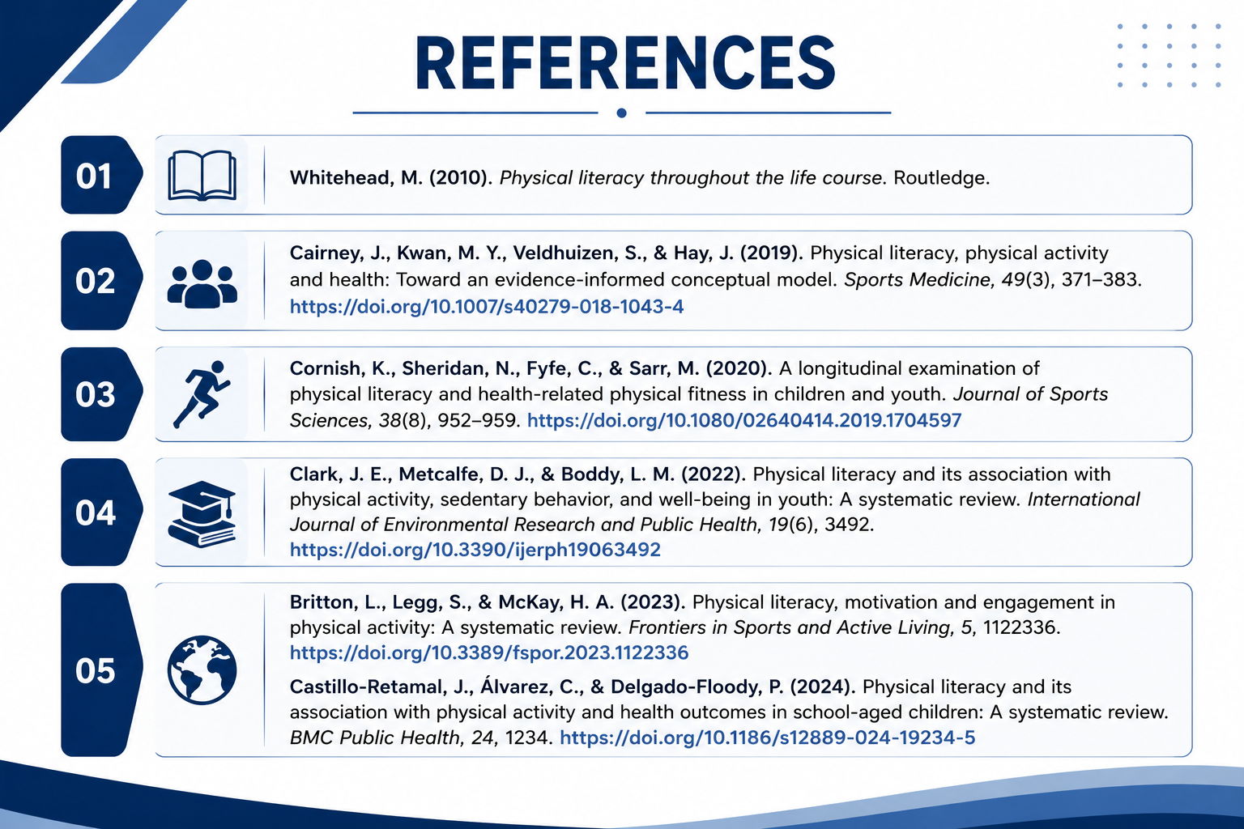

Slide 10

THANK YOU
UNIVERSITAS PENDIDIKAN INDONESIA

